Slide 1

ER Explanations & Robustness Analysis
Reporter: Daren Chao
Supervisor: Nick Koudas
Nov 11th, 2019
Notes:
ER: Entity Resolution

Slide 2

Outline
Explainer - LIME
ER Explainer – Mojito
Robustness of Classifiers
DeepFool
Universal Adversarial Perturbation
Robustness of Explainers
ER Explanations
Notes:
Outline

Slide 3

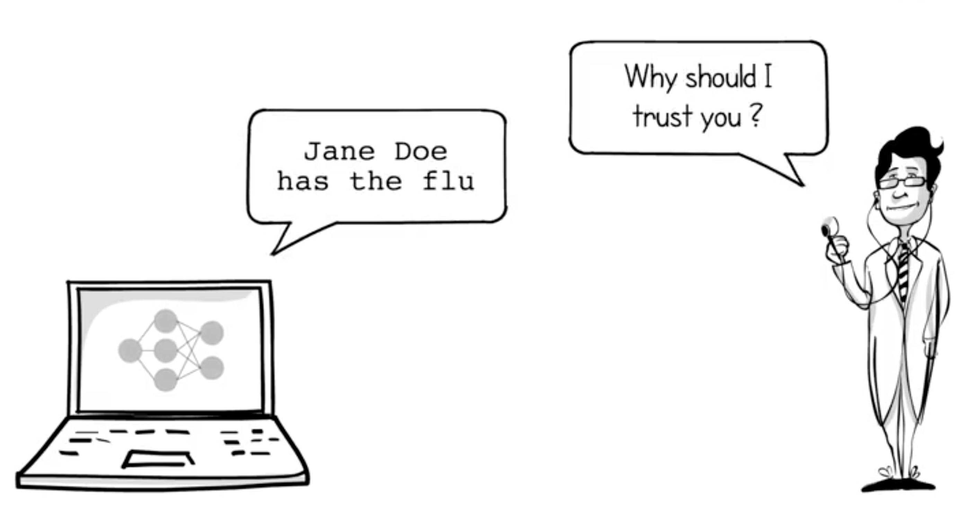
Sometimes you don’t know if you can trust a machine learning prediction.
Why do we need Model Explanations?
Notes:
Why do we need explainers?
Take a doctor for an example, he can not trust a diagnosis just because a computer said so.

Slide 4
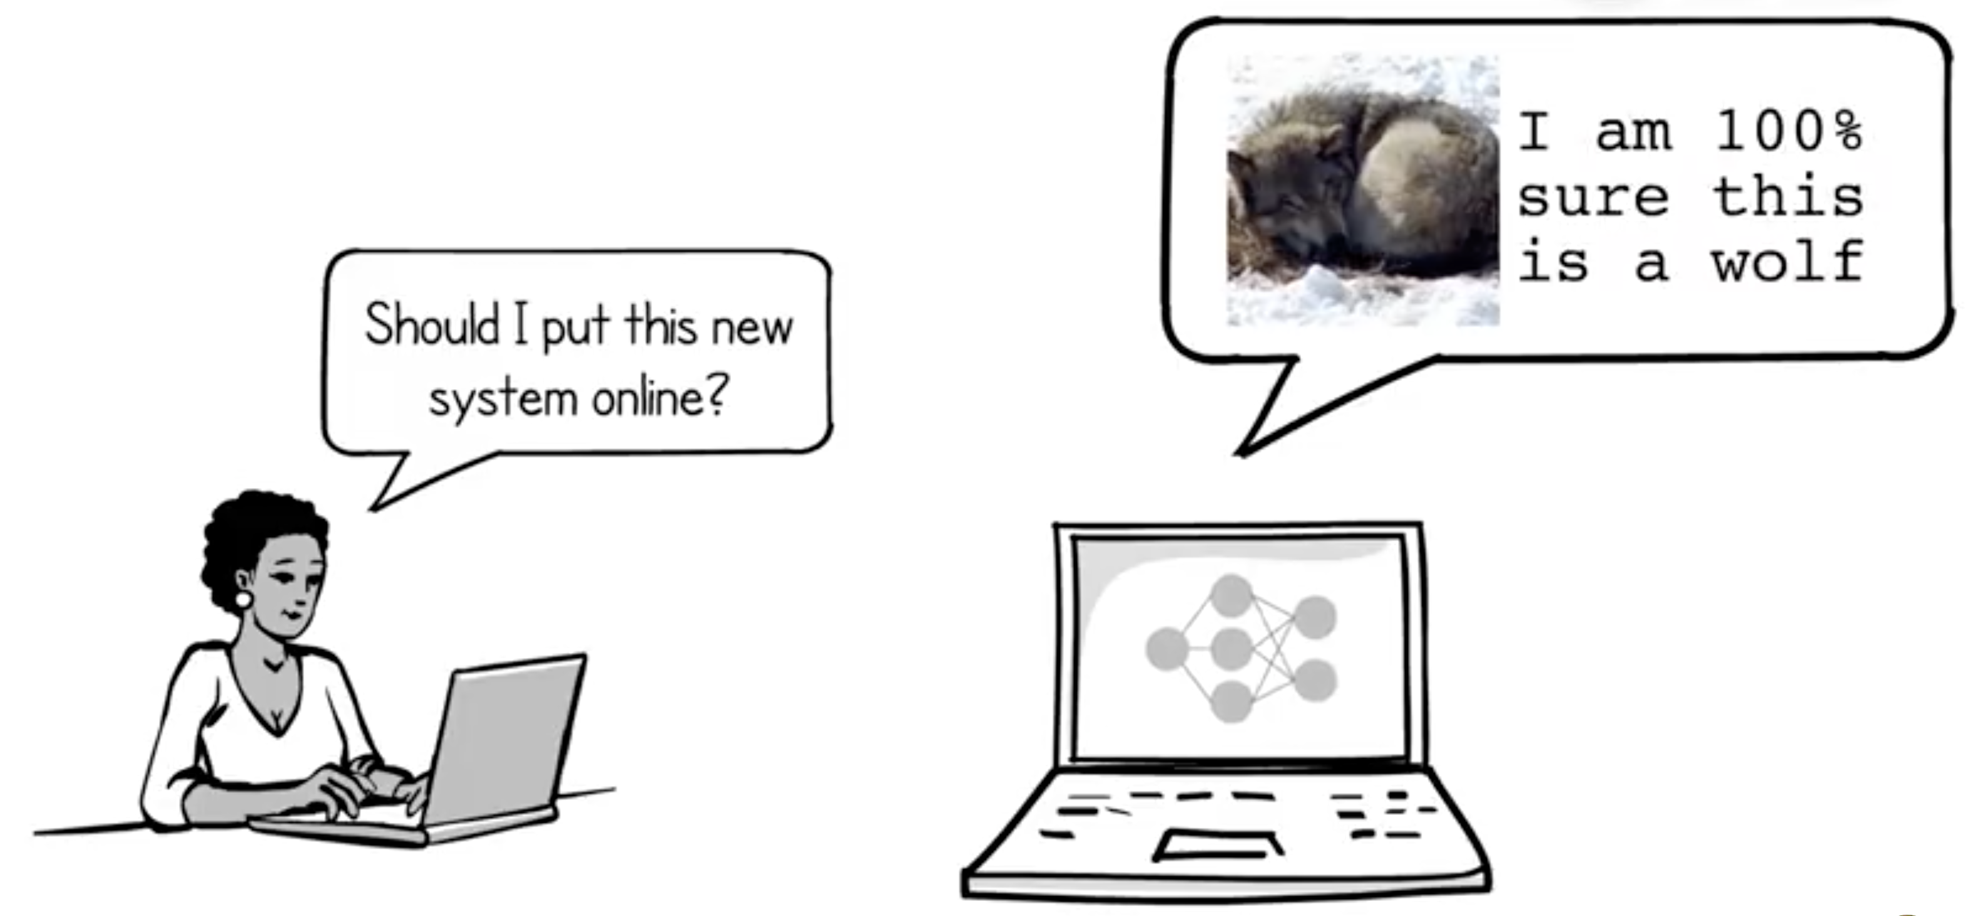
Also need to know if you can trust a model...
Why do we need Model Explanations?
Notes:
We also need to know if we can trust a model before using its predictions.
Let’s say we have a machine learning system that can detect wolfs. We can look at accuracy at some of the detections. They may look good. But is that enough for us to trust a machine learning system?

Slide 5
A classifier identifies the huskies as wolves.
Why do we need Model Explanations?
Notes:
Here is an example.
A classifier identifies the huskies as wolves.
Our direct explanation may be that the classifier has misjudged.
After all, the model itself is unlikely to be 100% correct.

Slide 6
Here is what an explainer dose.
Why do we need Model Explanations?
Notes:
But if we look at the second picture, we will find out what is happening when this sample is recognized as a wolf:
"The model didn't even look at the Huskie's face. It just classified the picture into a wolf by the background - the snow."
It's not reasonable.

Slide 7
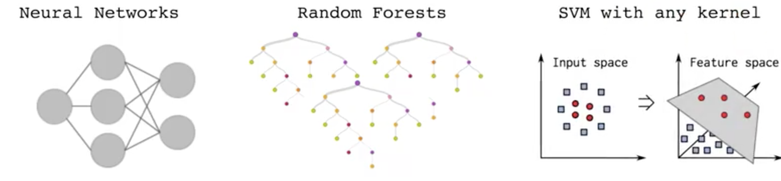
What if you could understand why any classifier is making a prediction?
Why do we need Model Explanations?
Notes:
We need an explainer to help us understand why any classifier is making a prediction, even in really complicated models.
Such as Neural Networks, Random Forests or SVM with any kernel.
# 解释为啥难

Slide 8
Drawbacks of Metrics
Real-world data is often significantly different from annotated data.
The evaluation metrics may not be indicative of the product’s goal.
Causing a wrong assessment of the model.
Why do we need Model Explanations?
Notes:
Traditionally, we use metrics to evaluate whether a model can return good predictions.
But as I have just said, metrics may cause many problems in practical applications.
First, ...
Second, there may be a conflict between metrics and the product’s goal.
Third, metrics may cause the machine learning practitioners to have a wrong assessment of the model, and the explanations can correct this assessment.

Slide 9
94% held-out accuracy
Notes:
Here is an example, the comparison of a variety of models with the help of explanations.
Both of them get the correct prediction, atheism.
Which model is better?
Actually, the right side is a SVM with RBF kernel. If you see its accuracy, 94% held-out accuracy.
We would be tempted to trust it based on the accuracy, while the explanation for this instance shows that predictions are made for quite arbitrary reasons.
The words “Posting”, “Host”, and “Re” have no connection to either Christianity or Atheism.
They might just made the prediction by chance or overfitting.
Undoubtedly this model will be sensitive to the input data set.

Slide 10
Content Recommendation
High accurate model
“clickbait” articles
hurt user retention
increases the accuracy in cross validation
Appropriate model
lower importance of “clickbait” articles
Sacrificing the accuracy
Why do we need Model Explanations?
Notes:
For the task of !!content recommendation.
解释：Content Recommendation is to choose articles from a set of them to show them to the users.
With the help of a explainer, a machine learning practitioner may wish to choose a less accurate model that does not place high importance in features related to “clickbait” articles (which may hurt user retention and engagement),
even if exploiting such features increases the accuracy of the model in cross validation.
联系

Slide 11
Requirements for Explainers
Interpretable
Connections between “input variables” and the response
Local Fidelity
Model-Agnostic
Global Perspective
How can we design a Model Explainer?
Notes:
Before designing a model explainer, we get four requirements.
First, it is an essential criterion for the explanation to be interpretable; to be interpretable means to give understanding between the input variables and the response.
This connection between the input variables and the response should be easy for humans to understand. If a model uses thousands of features to get a prediction, even if all the weights used by the model can be inferred, it is impossible for a human to analyze these bunch of features one by one.
Sometimes the “input variables” can be different from actual features used by the model. Also this explanation should depends on the target audience.

Slide 12
Requirements for Explainers
Interpretable
Connections between “input variables” and the response
Local Fidelity
How a model behaves in the vicinity of the instance
Model-Agnostic
Treating the original model as a black box
Global Perspective
How can we design a Model Explainer?
Notes:
It is hard for an explanation to be global faithful, because it is not the model itself.
But it must at least be locally faithful.
It must reveal how the model behaves in the vicinity of the instance being predicted.
And also, an explainer should be able to explain any model, known as model-agnostic. It has to treat the original model as a black box.
Global perspective is important to ascertain trust in the model.
# We can select a few explanations for individual predictions to present to the user, such that they are representative of the model.

Slide 13
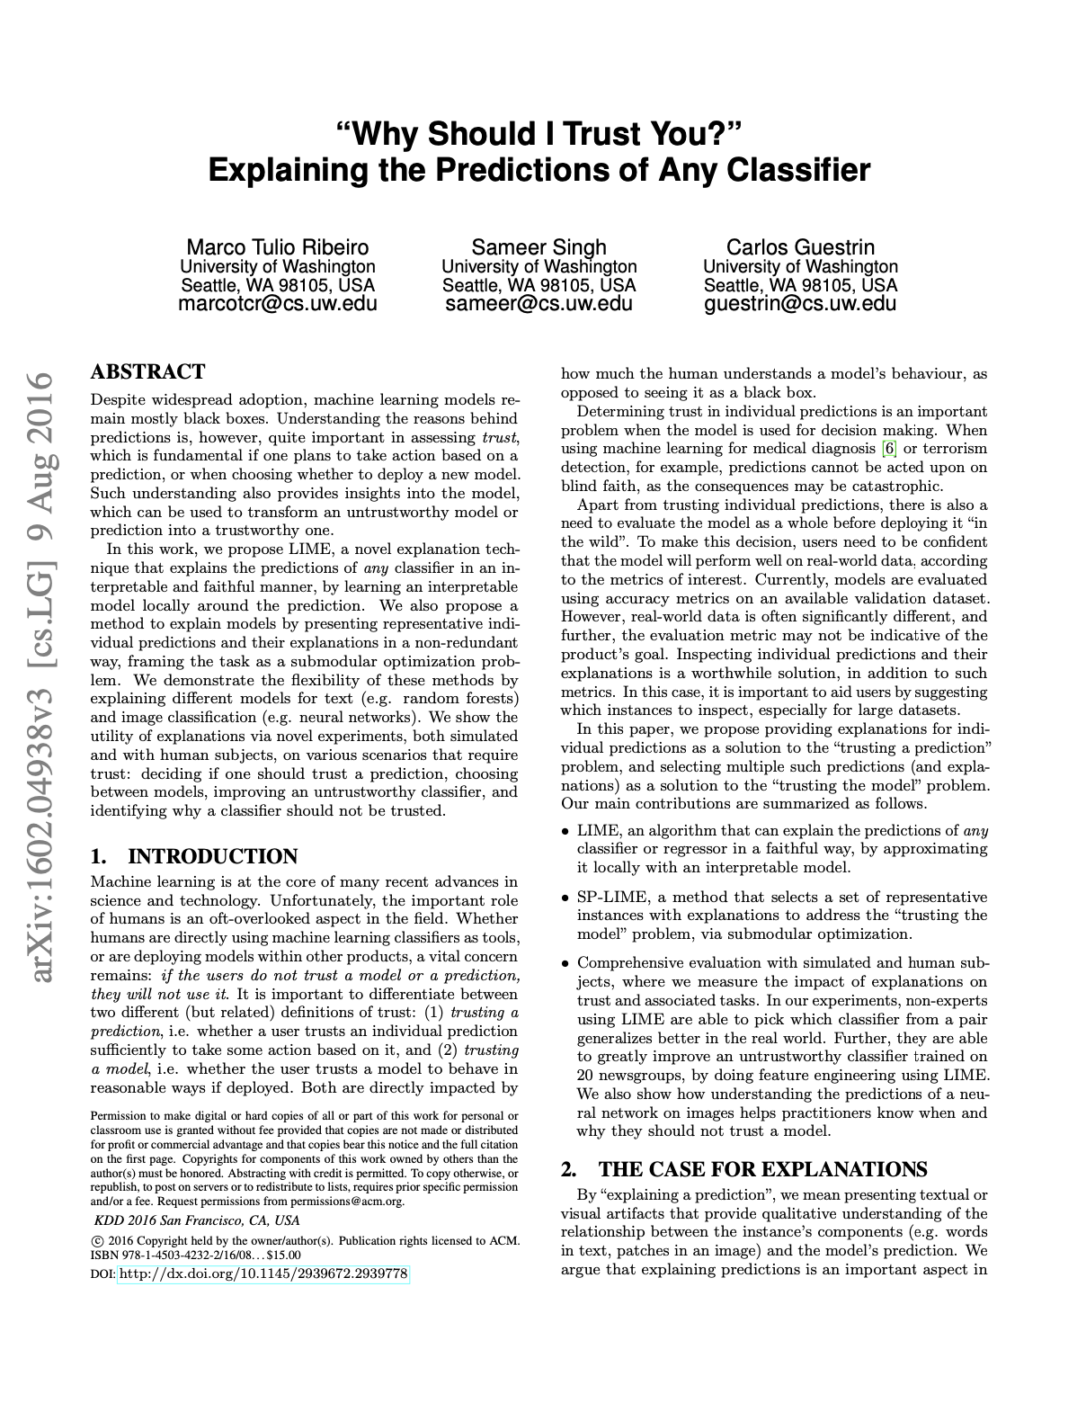
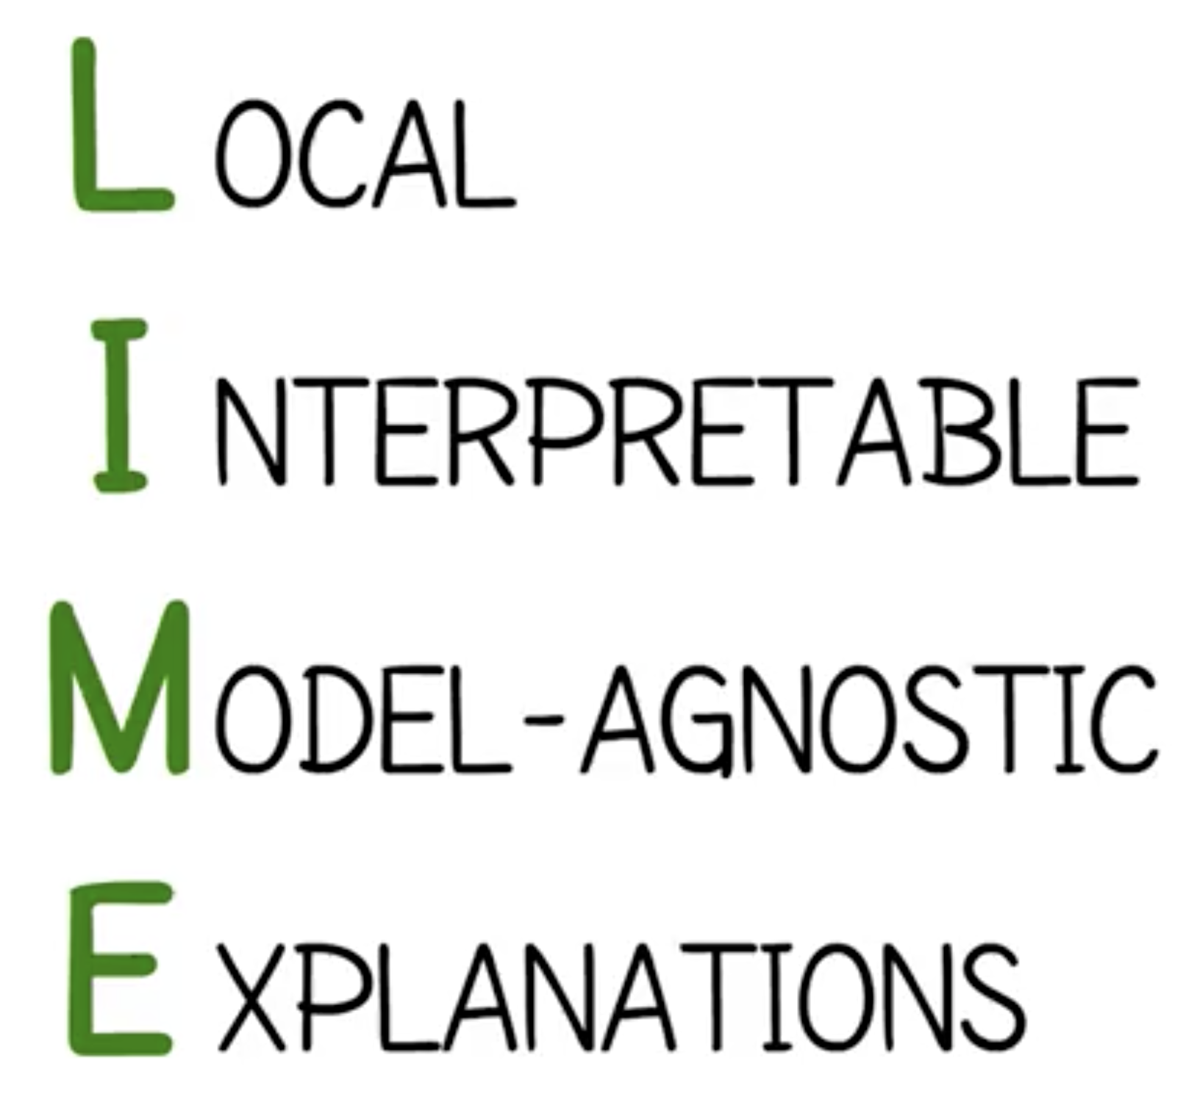
"Why Should I Trust You?" Explaining the Predictions of Any Classifier [1]
LIME: Explanation of predicts of any classifier or regressor.
SP-LIME: Explanation of models by selecting representation instances.
LIME: Explaining the Predictions of Any Classifier
Notes:
LIME is proposed to help us to understand why any classifier is making a prediction.
This paper also proposed the approach, SP-LIME, to explain the models by selecting representation instances.
LIME is short for local, interpretable, model-agnostic and explanations, as we have mentioned.

Slide 14
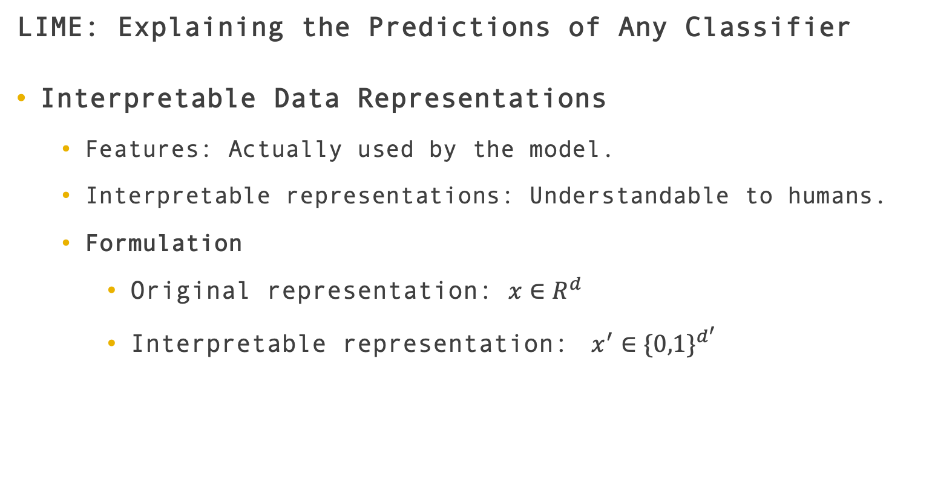
LIME: Explaining the Predictions of Any Classifier
Interpretable Data Representations
Features: Actually used by the model.
Interpretable representations: Understandable to humans.
Formulation
Original representation: $x∈R^{d}$
Interpretable representation: $x^{′}∈\{0,1\}^{d^{′}}$
LIME: Explaining the Predictions of Any Classifier
Notes:
First, we need interpretable data representations. As I have mentioned, the real features used by the model may be hard for users to understand. On the contrary, the paper introduced the interpretable representations.
x: d-dimensional features;
x-prime: d-prime-dimensional 0-or-1 representations

Slide 15
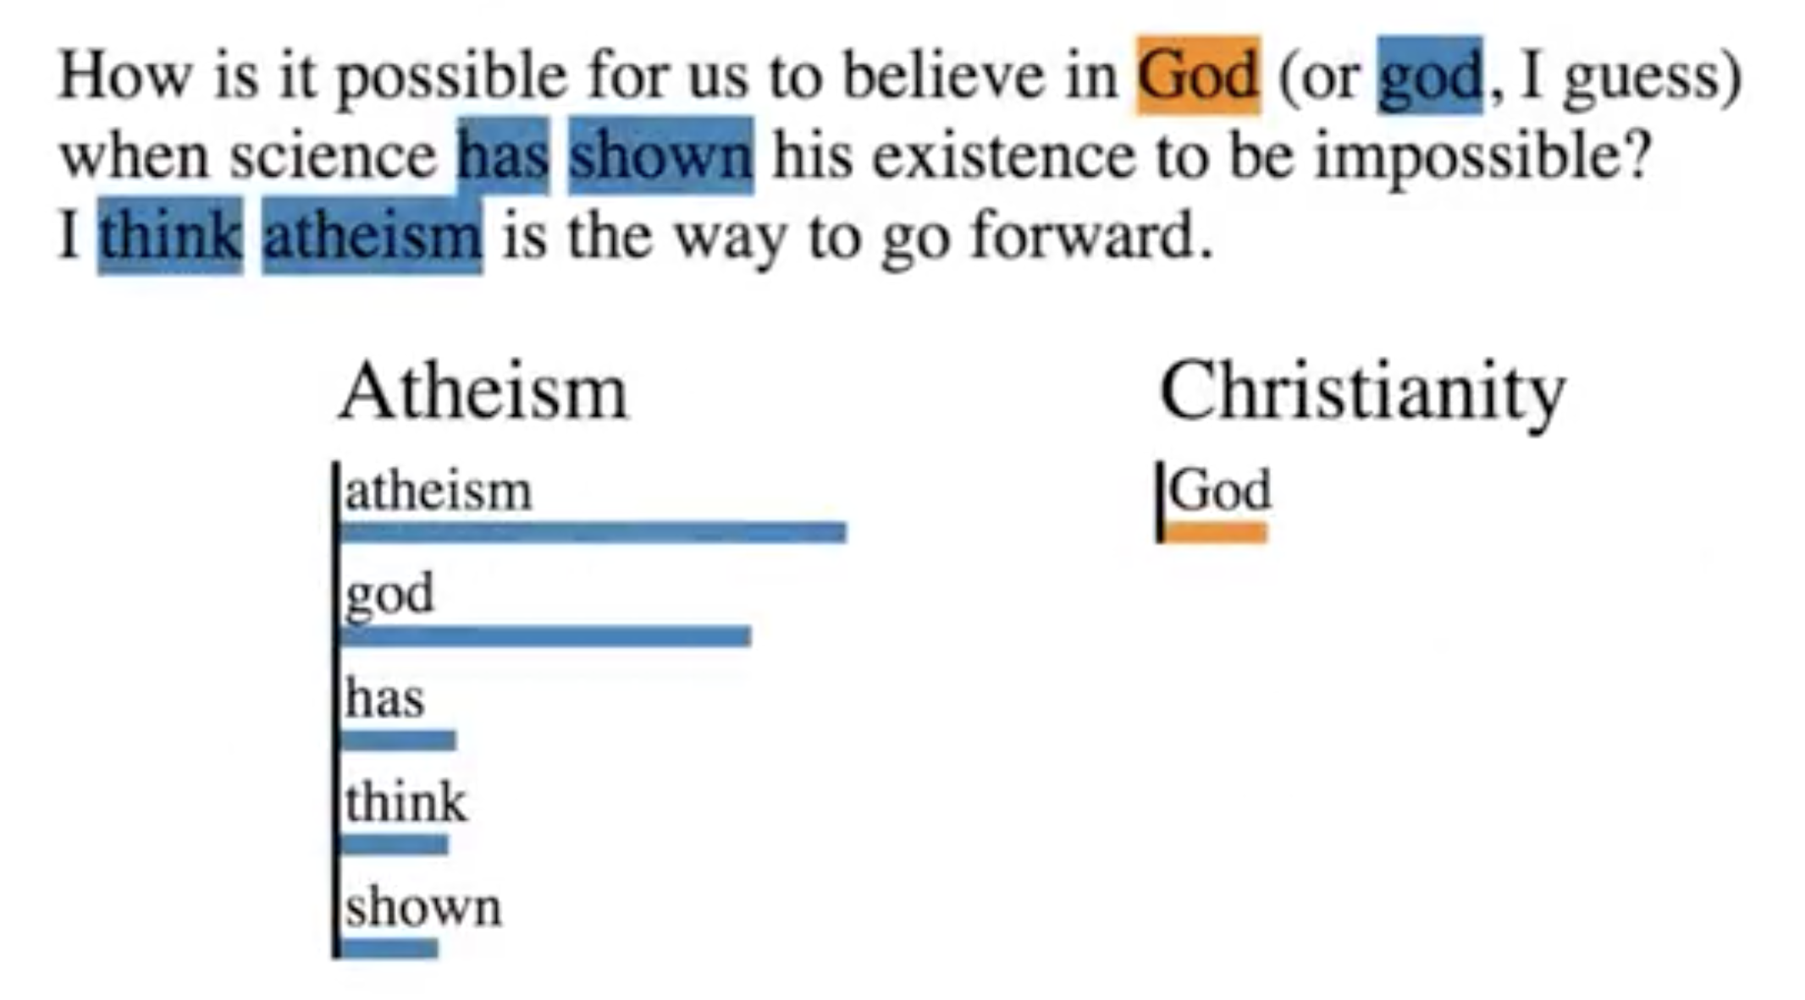
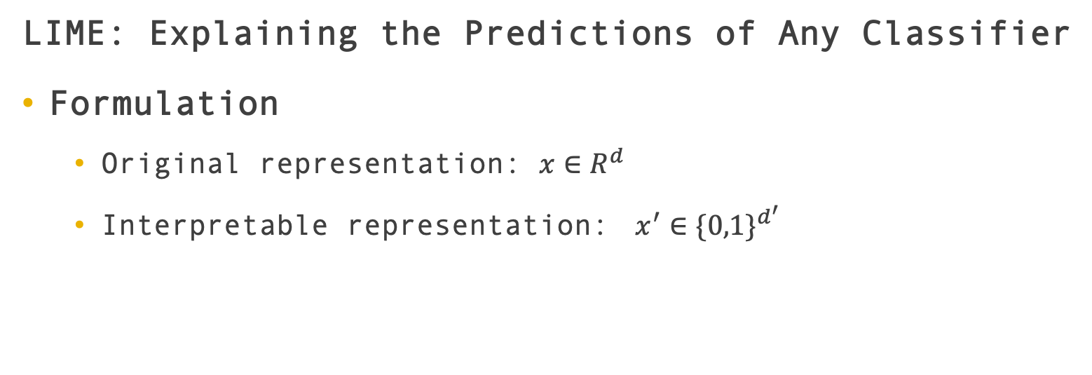
LIME: Explaining the Predictions of Any Classifier
Formulation
Original representation: $x∈R^{d}$
Interpretable representation: $x^{′}∈\{0,1\}^{d^{′}}$
LIME: Explaining the Predictions of Any Classifier
Notes:
For text classification, a possible interpretable representation is a binary vector indicating the presence or absence of a word, even though the classifier may use more complex features such as word embeddings.
For image classification, the classifier may represent the image as a tensor with three color channels per pixel.
While an interpretable representation may be a binary vector indicating the “presence” or “absence” of a contiguous patch of similar pixels (or a super-pixel).
解释super-pixel

Slide 16
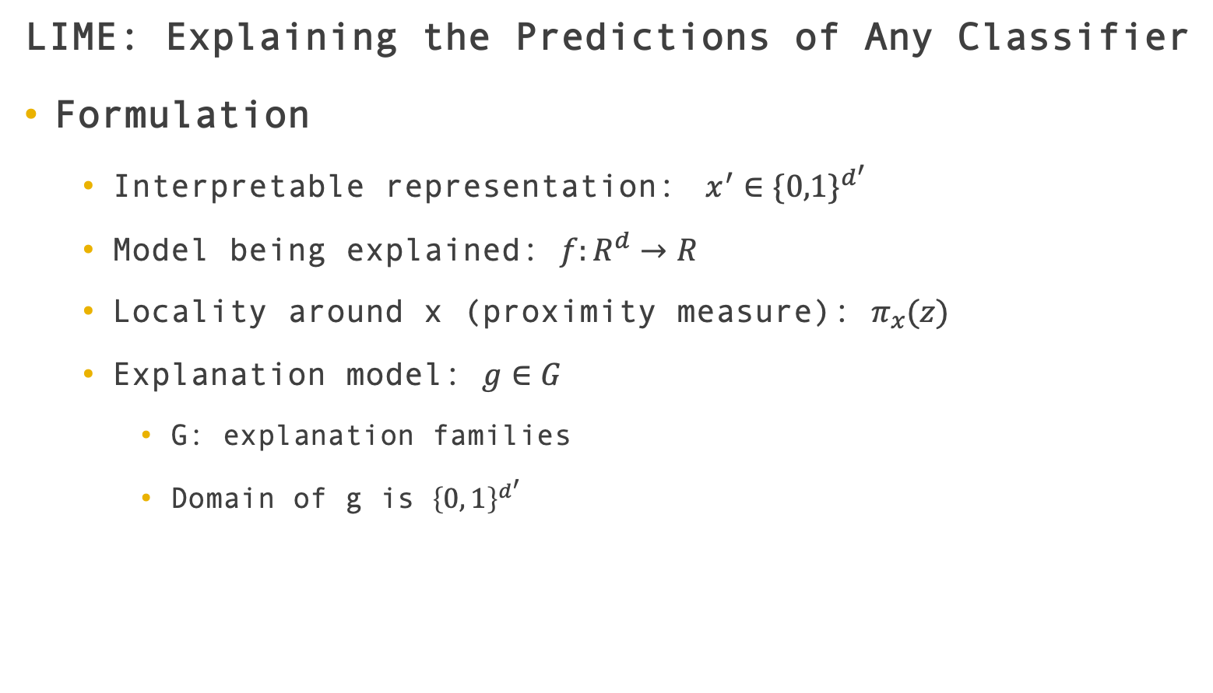
LIME: Explaining the Predictions of Any Classifier
Formulation
Interpretable representation: $x^{′}∈\{0,1\}^{d^{′}}$
Model being explained: $f:R^{d}→R$
Locality around x (proximity measure): $π_{x}(z)$
Explanation model: $g∈G$
G: explanation families
Domain of g is ${\left\{0, 1\right\}}^{d^{′}}$
LIME: Explaining the Predictions of Any Classifier
Notes:
Let’s see how it works
In classification, f(x) is the probabilities that x belongs to the classes.
We further use \pi_x(z) as a proximity measure between an instance z to x, so as to define locality around x.
We define an explanation as a model g ∈ G, G is explanation families, is a set of potentially interpretable models, such as linear models, decision trees, or falling rule lists.
The domain of g is the absence/presence of the interpretable components.
# These models must be able to be presented to the user with visual or textual artifacts.

Slide 17
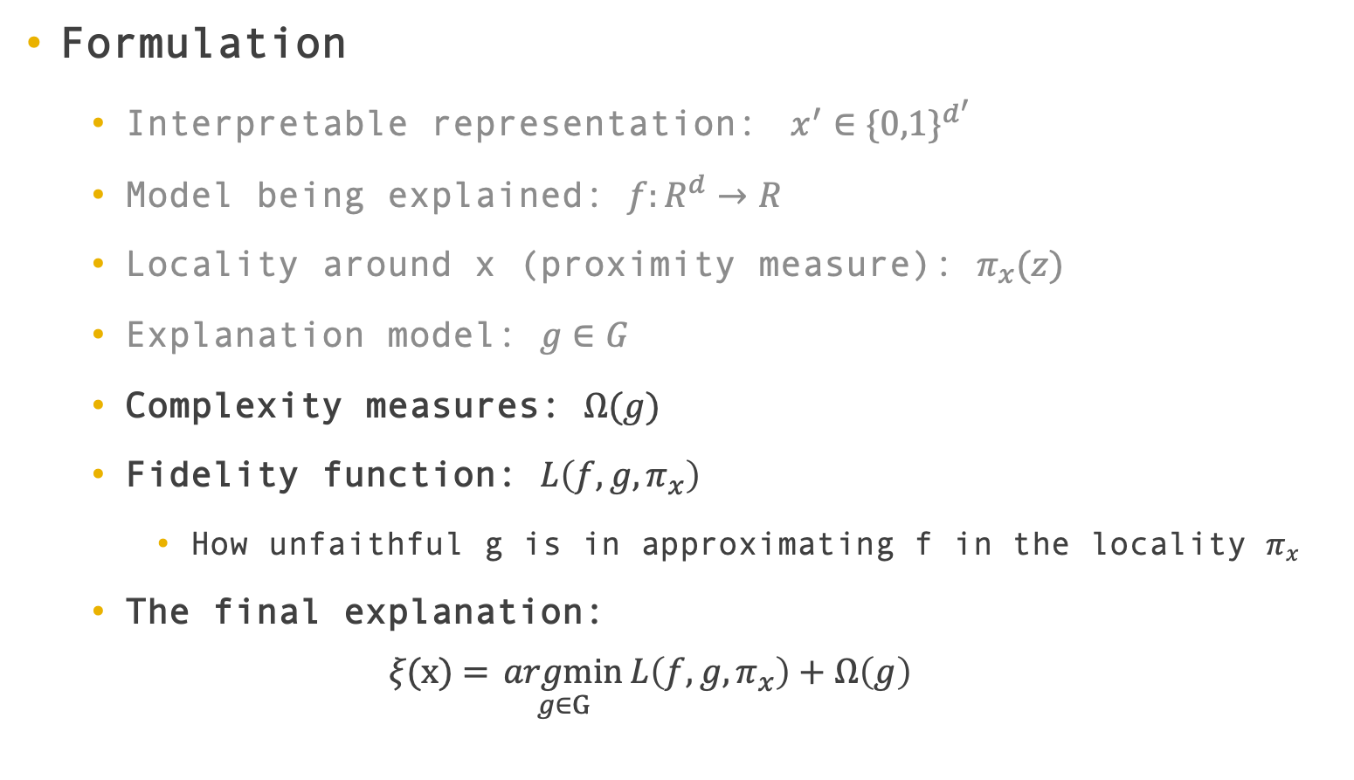
Formulation
Interpretable representation: $x^{′}∈\{0,1\}^{d^{′}}$
Model being explained: $f:R^{d}→R$
Locality around x (proximity measure): $π_{x}(z)$
Explanation model: $g∈G$
Complexity measures: $Ω(g)$
Fidelity function: $L\left(f,g,π_{x}\right)$
How unfaithful g is in approximating f in the locality $π_{x}$
The final explanation:
$$ξ\text{(}\text{x}\text{) =} \underset{g∈G}{argmin}{L\left(f,g,π_{x}\right)+Ω\left(g\right)}$$
LIME: Explaining the Predictions of Any Classifier
Notes:
And also, we need complexity measures to measure whether an explain is really interpretable.
The higher it is, the lower interpretability it has.
For a decision tree, the Ω(g) could be the depth of the tree; for linear models, Ω(g) may be the number of non-zero weights.
The fidelity function is a measure of how unfaithful g is in approximating f in the locality pi_x.
At the same time, Ω(g) should also be low enough to be interpretable by humans.
The finally explanation produced by LIME is obtained by (The function).

Slide 18
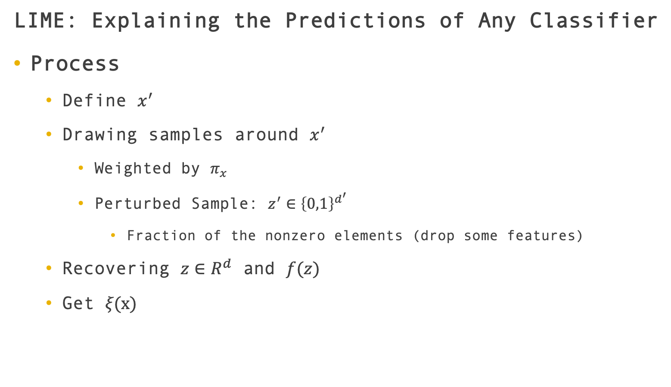
LIME: Explaining the Predictions of Any Classifier
Process
Define $x^{′}$
Drawing samples around $x^{′}$
Weighted by $π_{x}$
Perturbed Sample: $z^{′}∈{\left\{0,1\right\}}^{d^{′}}$
Fraction of the nonzero elements (drop some features)
Recovering $z∈R^{d}$ and $f(z)$
Get $ξ\text{(}\text{x}\text{)}$
x’
nonzero elements
z’
z
f(z)
Z
ξ(x)
LIME: Explaining the Predictions of Any Classifier
Notes:
Firstly, we need define the interpretable representation of x: x_prime.
In order to learn the local behavior of f, we draw some samples, weighted by pi_x.
The perturbed sample contains a fraction of the nonzero elements which around x’, which means dropping nonzero elements of x′ uniformly at random.
Then the sample is recovered in the original representation to get z and f(z) which is used as a label for the explanation model.
Given this dataset Z of perturbed samples with the associated labels, we optimize the above equation to get an explanation ξ(x).

Slide 19
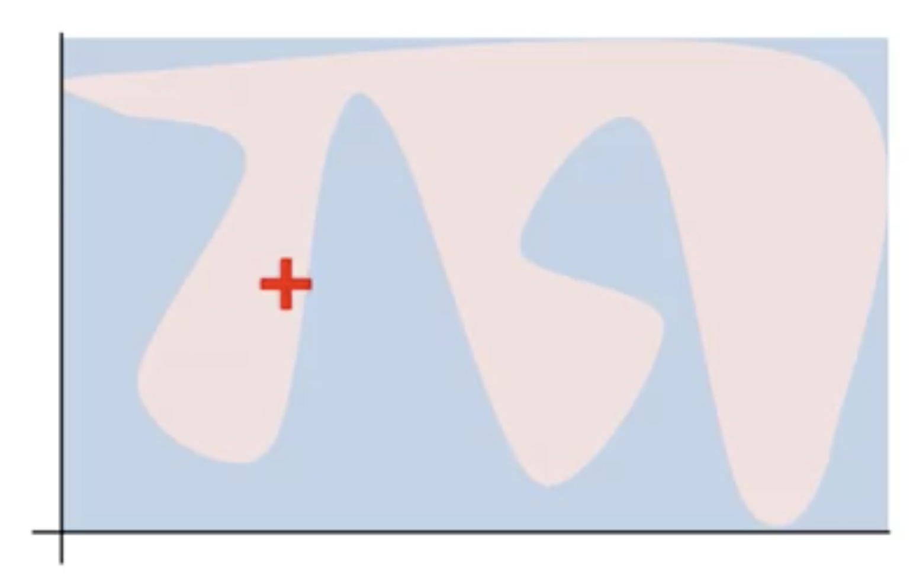
LIME: Explaining the Predictions of Any Classifier
Example: Two-Dimensional Binary Classification
Black-box model
Complex decision function f (unknown to LIME)
Red Cross: instance to be explained
LIME: Explaining the Predictions of Any Classifier
Notes:
To help you understand the process of LIME, I prepared an example: Two-Dimensional Binary Classification.
This is a black-box model. A complex decision function f (unknown to LIME) is represented by the blue/pink background, which cannot be approximated well by a linear model.
The bold red cross is the instance being explained.

Slide 20
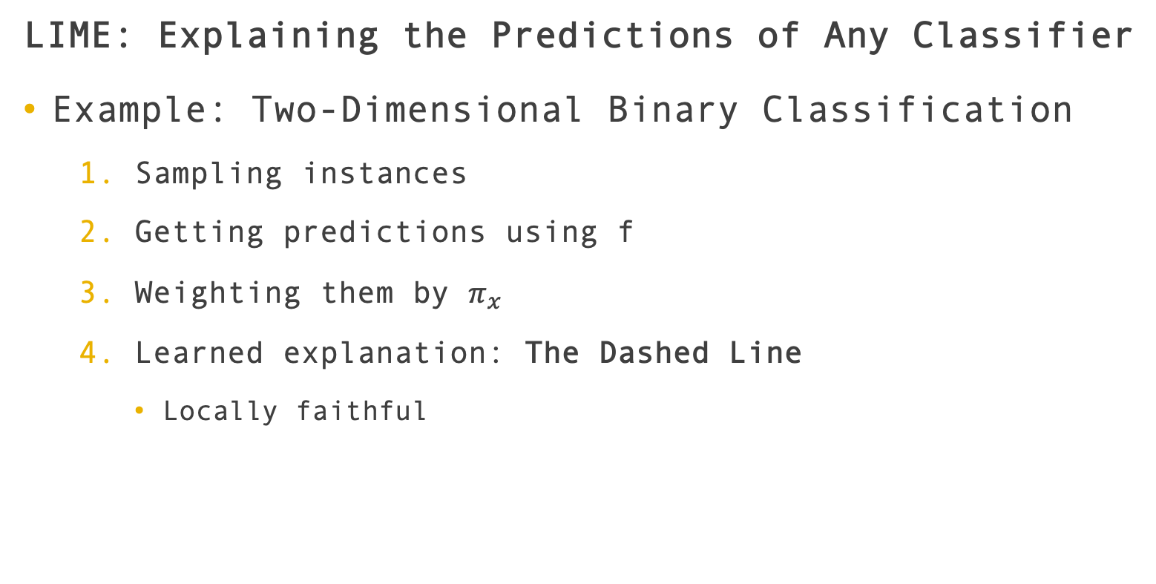
LIME: Explaining the Predictions of Any Classifier
Example: Two-Dimensional Binary Classification
Sampling instances
Getting predictions using f
Weighting them by $π_{x}$
Learned explanation: The Dashed Line
Locally faithful
LIME: Explaining the Predictions of Any Classifier
Notes:
LIME samples instances,
gets predictions using f,
and weighs them by the proximity to the instance being explained (represented here by size).
Finally, the dashed line is the learned explanation that is locally (but not globally) faithful.
This is a local, interpretable and model-agnostic explanation.

Slide 21
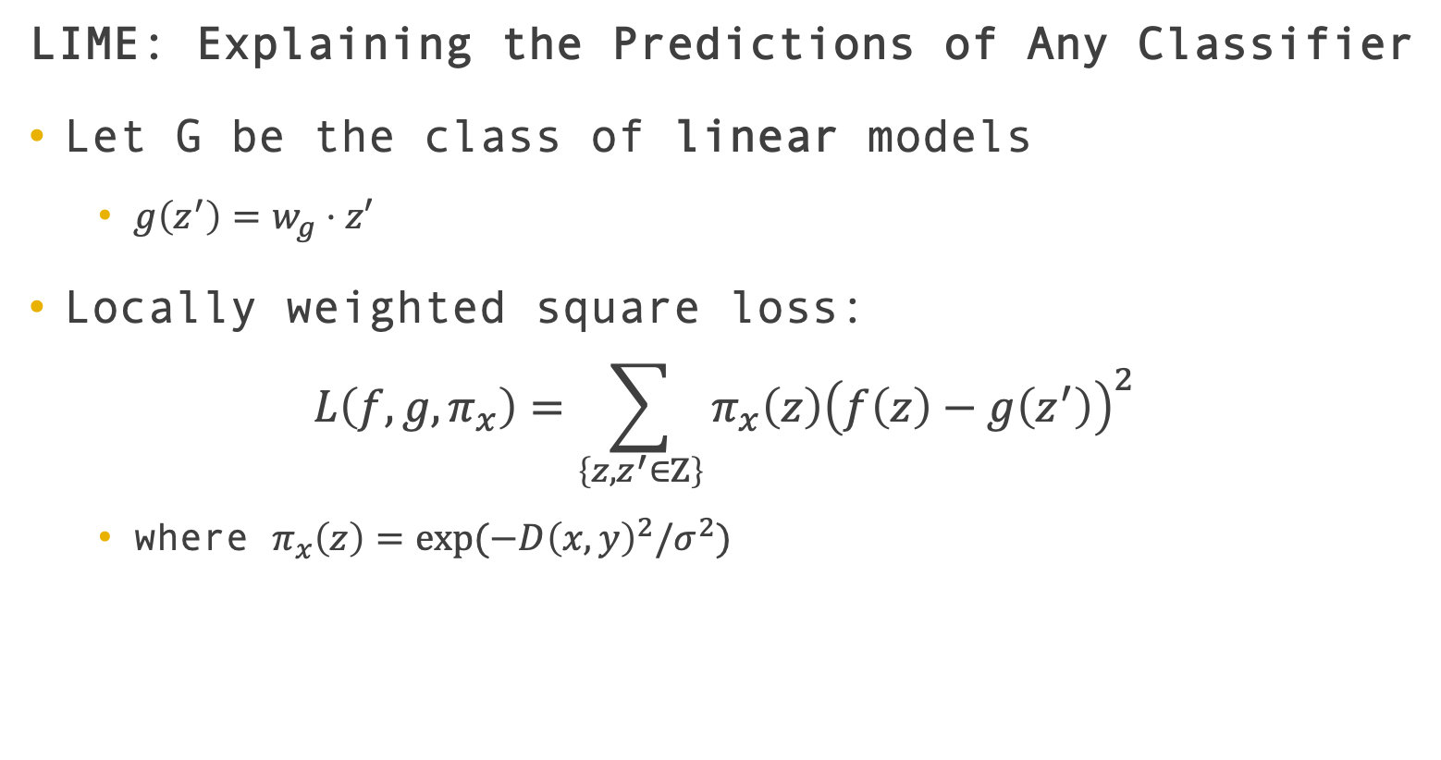
LIME: Explaining the Predictions of Any Classifier
Let G be the class of linear models
$g\left(z^{′}\right)=w_{g}⋅z′$
Locally weighted square loss:
$$L\left(f,g,π_{x}\right)=\sum_{\left\{z,z^{′}∈Z\right\}}{π_{x}\left(z\right){\left(f\left(z\right)−g\left(z^{′}\right)\right)}^{2}}$$
where $π_{x}\left(z\right)=exp⁡(−D{\left(x,y\right)}^{2}/σ^{2})$
LIME: Explaining the Predictions of Any Classifier
Notes:
We found linear models are very suitable for our explanations here, so just let G be the class of linear models. We have $g\left(z^{′}\right)=w_{g}⋅z′$ .
And also, using the locally weighted square loss to estimate how unfaithful g is in approximating f.
$π_{x}$ is an exponential kernel defined on some distance function D with width σ.
For example, for text, D is cosine distance; for images, D is L2 distance.

Slide 22
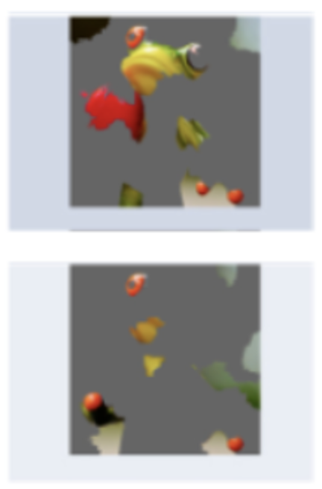


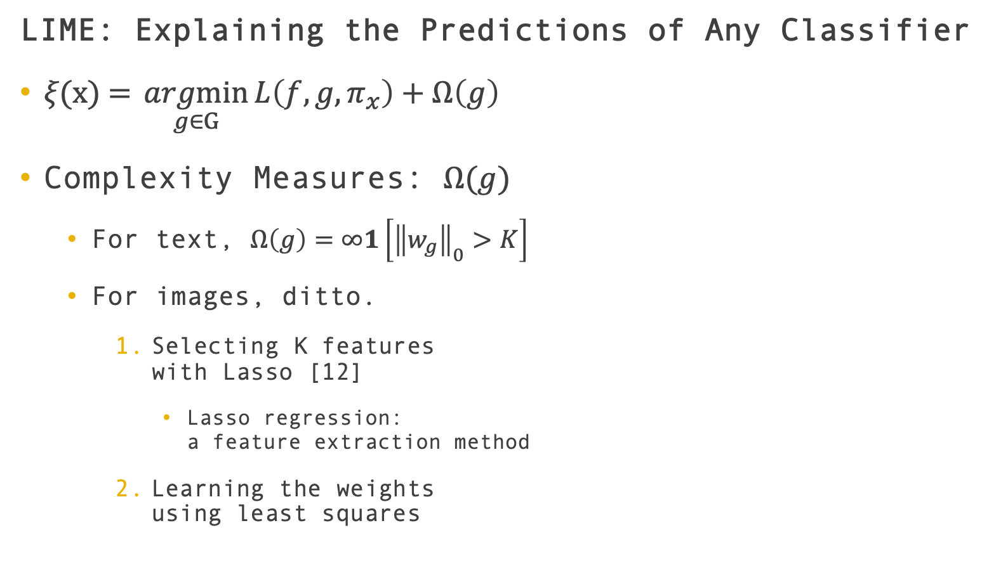
LIME: Explaining the Predictions of Any Classifier
$ξ\text{(}\text{x}\text{) =} \underset{g∈G}{argmin}{L\left(f,g,π_{x}\right)+Ω\left(g\right)}$
Complexity Measures: $Ω(g)$
For text, $Ω\left(g\right)=∞1\left[{\left\|w_{g}\right\|}_{0}>K\right]$
For images, ditto.
Selecting K features with Lasso [12]
Lasso regression: a feature extraction method
Learning the weights using least squares
LIME: Explaining the Predictions of Any Classifier
Notes:
Other than loss function, we also need the complexity measures.
For text classification, we use a bag of words to denote interpretable representation, and set a limit K on the number of words.
$Ω\left(g\right)$ is infinity if the number of non-zero values in w_g is greater than K, otherwise $Ω\left(g\right)$ is 1.
We use the same Ω(g) for image classification.
While image explanations use “super-pixels” instead of words, such that the interpretable representation of an image is a binary vector where 1 indicates the original super-pixel and 0 indicates a grayed out super-pixel.
However, this Omega will make it hard at solving the explanation equation. So they firstly use Lasso to select K features and then then learn the weights using least squares.

Slide 23
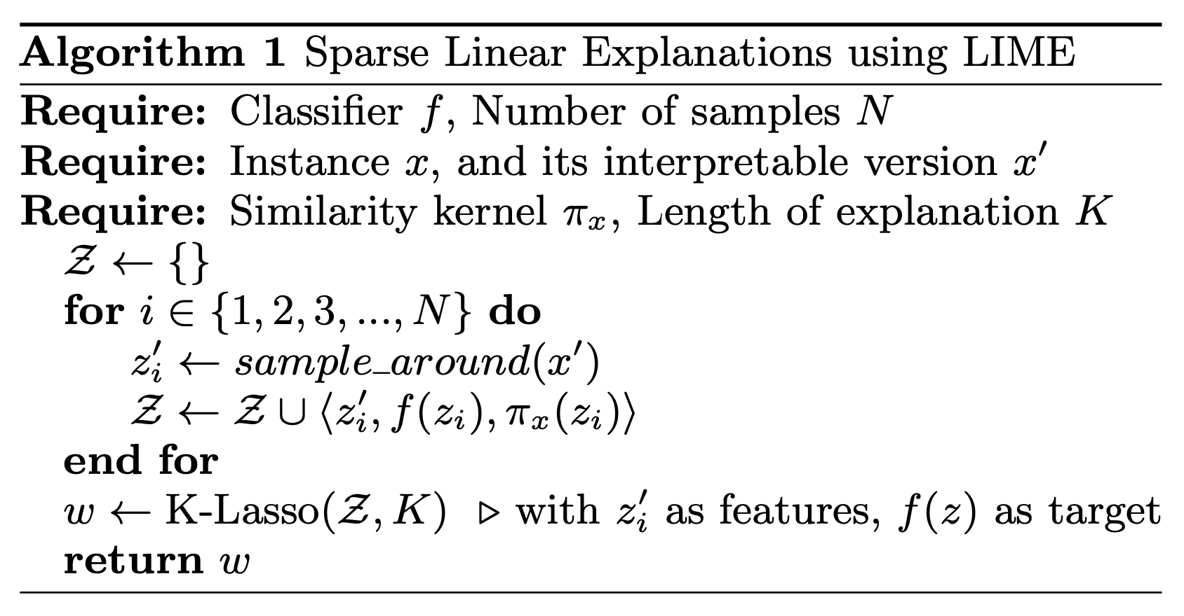
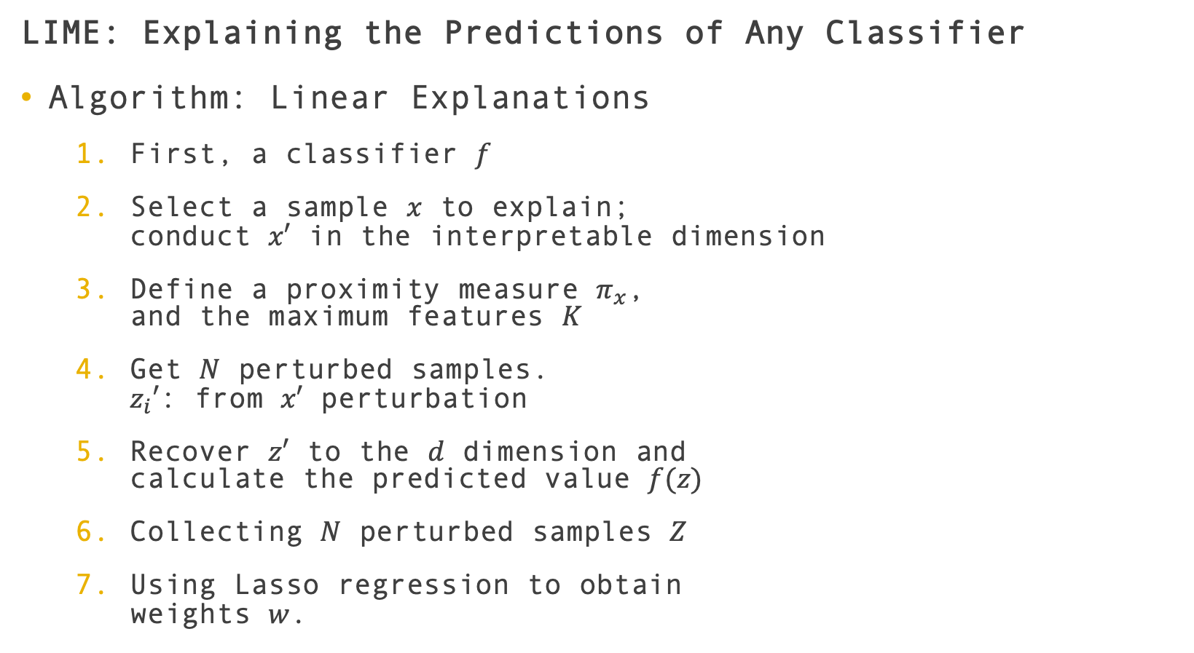
LIME: Explaining the Predictions of Any Classifier
Algorithm: Linear Explanations
First, a classifier $f$
Select a sample $x$ to explain; conduct $x′$ in the interpretable dimension
Define a proximity measure $π_{x}$, and the maximum features $K$
Get $N$ perturbed samples. $z_{i}′$: from $x′$ perturbation
Recover $z′$ to the $d$ dimension and calculate the predicted value $f(z)$
Collecting $N$ perturbed samples $Z$
Using Lasso regression to obtain weights $w$.
LIME: Explaining the Predictions of Any Classifier

Slide 24
LIME: Explaining the Predictions of Any Classifier
Complexity
Relying on f(x) and N
3 seconds for explaining random forests with 1000 trees on a laptop with N = 5000
10 minutes for explaining deep neural network (Inception Network[4]).
LIME: Explaining the Predictions of Any Classifier
Notes:
Speed.
Its complexity depends on time to compute f(x) and on the number of samples N.
In practice, explaining random forests with 1000 trees on a laptop with N = 5000 takes under 3 seconds without any optimizations such as using gpus or parallelization
Explaining each prediction of the deep neural network for image classification takes around 10 minutes.

Slide 25
LIME: Explaining the Predictions of Any Classifier
Limitations
Certain interpretable representations will not be powerful enough to explain certain behaviors.
For example, a model that predicts sepia-toned images to be retro cannot be explained by presence or absence of super pixels.
LIME: Explaining the Predictions of Any Classifier
Notes:
Of cause the model has some limitations.
The first thing is that certain interpretable representations will not be powerful enough to explain certain behaviors.
For example, a model that predicts sepia-toned images to be retro cannot be explained by presence or absence of super pixels.

Slide 26
LIME: Explaining the Predictions of Any Classifier
Limitations
Certain interpretable representations will not be powerful enough to explain certain behaviors.
For example, a model that predicts sepia-toned images to be retro cannot be explained by presence or absence of super pixels.
The explanation won’t be faithful if the underlying model is highly non-linear even in the locality of the prediction.
LIME: Explaining the Predictions of Any Classifier
Notes:
The explanation won’t be faithful if the underlying model is highly non-linear even in the locality of the prediction.

Slide 27
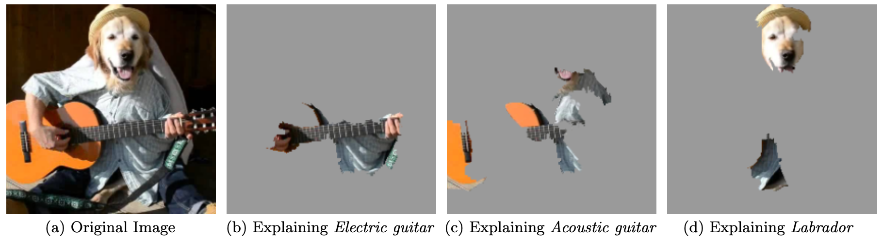
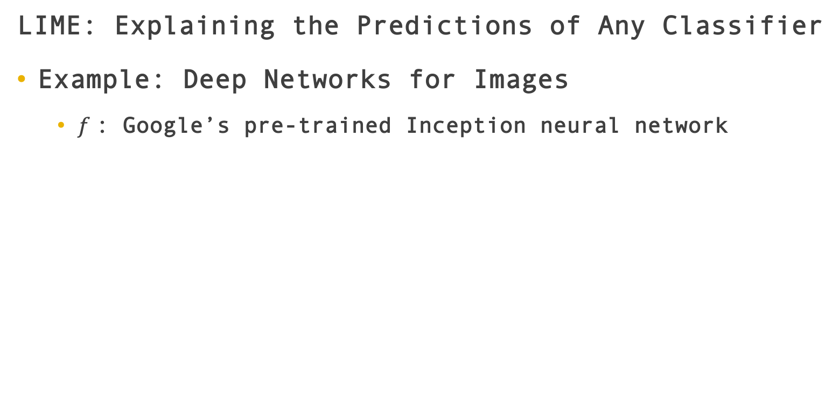
LIME: Explaining the Predictions of Any Classifier
Example: Deep Networks for Images
$f$: Google’s pre-trained Inception neural network
LIME: Explaining the Predictions of Any Classifier
Notes:
This paper explained the prediction of Google’s pre-trained Inception neural network on this image, an arbitrary image.
(b), (c), (d) show the super-pixel explanations for the top 3 predicted classes.
The rest of the image has been grayed out.
For each classes, the information obtained by the neural network is natural for humans.
Figure b explained why acoustic guitar was predicted to be electric: due to the fretboard.
This kind of explanation enhances trust in the classifier (even if the top predicted class is wrong), as it shows that it is not acting in an unreasonable manner.

Slide 28

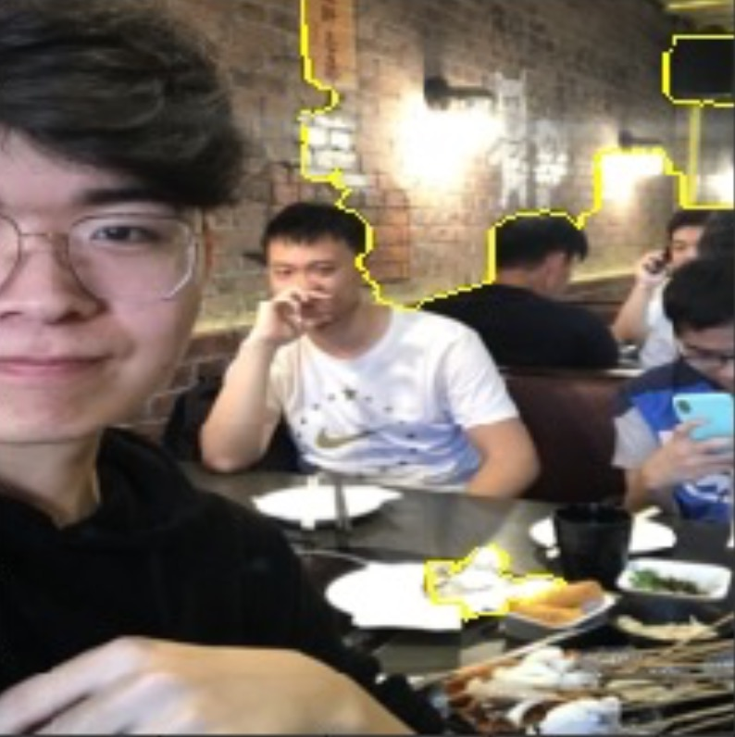
LIME: Explaining the Predictions of Any Classifier
Example: Deep Networks for Images
Source code [10]
why restaurant
restaurant: 0.97997963
wok: 0.0042263796
candle: 0.003481857
LIME: Explaining the Predictions of Any Classifier
Notes:
To give another example, two of our classmates and I are eating in a restaurant.

Slide 29
SP-LIME: Submodular Pick for Explaining Models
Other methods (like Modeltracker[5]):
Assisting users in selecting instances themselves
Improvement:
Raw data is not enough
Taking into account the explanations for pick step
Objective:
Diverse
representative
Non-redundant
SP-LIME: Submodular Pick for Explaining Models
Notes:
As I have mentioned, they try to give a global understanding of the model by explaining a set of individual instances.
Some other methods assist users in selecting instances themselves, and then examining the raw data and predictions.
This paper thought that looking at raw data is not enough to understand predictions; so the pick step should take into account the explanations that accompany each prediction.
This objective for the model should be picking a diverse, representative, non-redundant set of explanations to show the user.
These instances/explanations should represent how the model behaves globally.

Slide 30
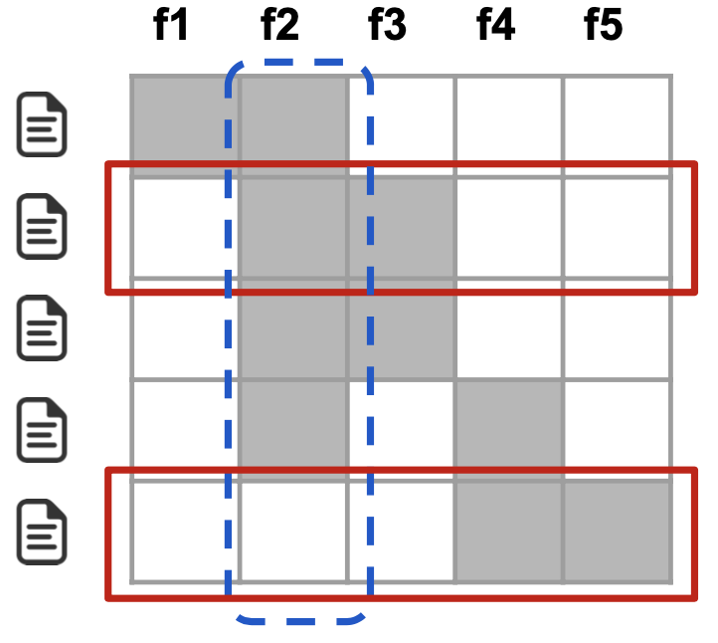
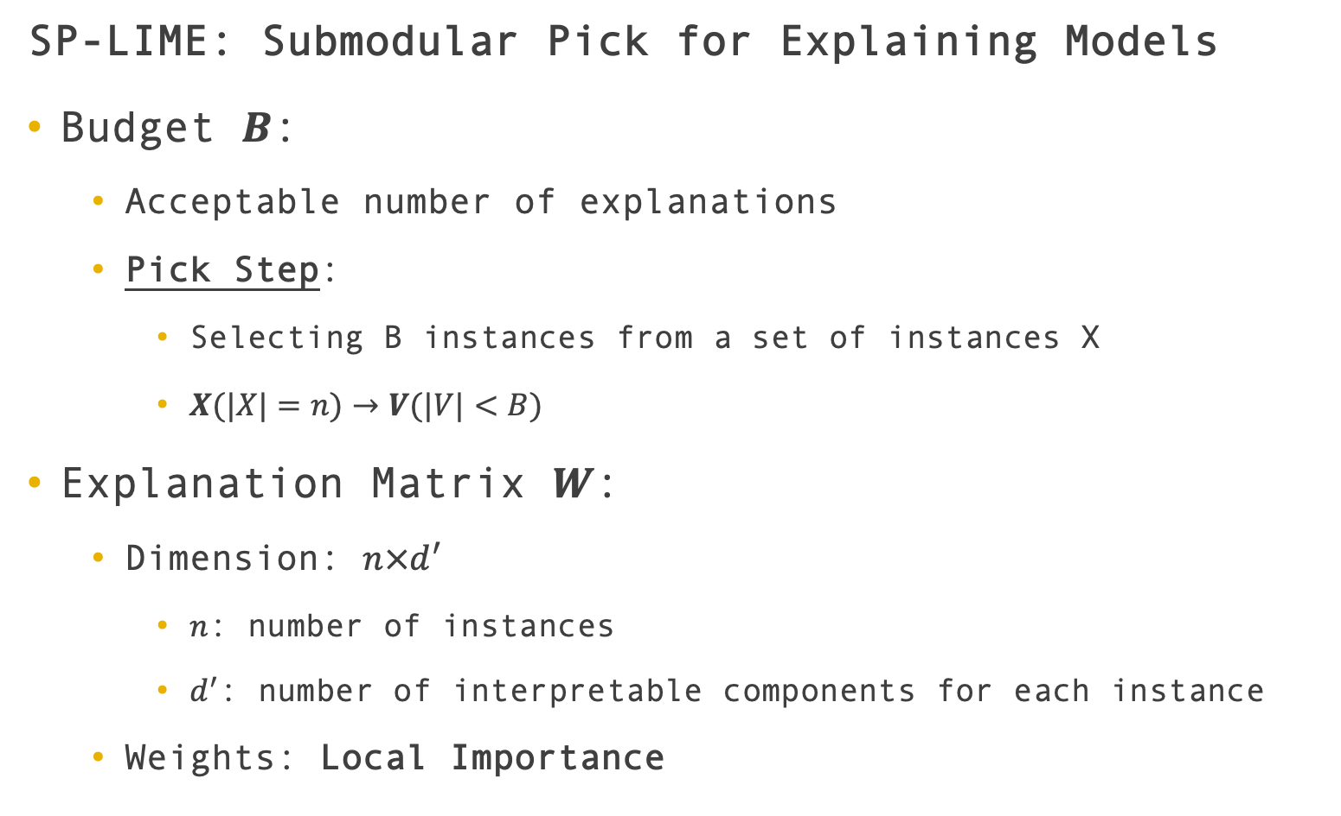
SP-LIME: Submodular Pick for Explaining Models
Budget $B$:
Acceptable number of explanations
Pick Step:
Selecting B instances from a set of instances X
$X(|X|=n)→V(|V|<B)$
Explanation Matrix $W$:
Dimension: $n×d^{′}$
$n$: number of instances
$d^{′}$: number of interpretable components for each instance
Weights: Local Importance
SP-LIME: Submodular Pick for Explaining Models
Notes:
We use the budget B to measure the patience that humans have.
B denotes the number of explanations they are willing to look at in order to understand a model.
Given a set of instances X, we define the pick step as the task of selecting B instances for the user to inspect.
We construct an explanation matrix w, which is n times d-prim,
where n is the number of instances and d-prime is the number of interpretable components for each instance.
W is to represents the local importance of the interpretable components.
Here is an example of w. Rows represent instances (i.e. documents) and columns represent features (i.e. words).

Slide 31
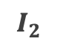
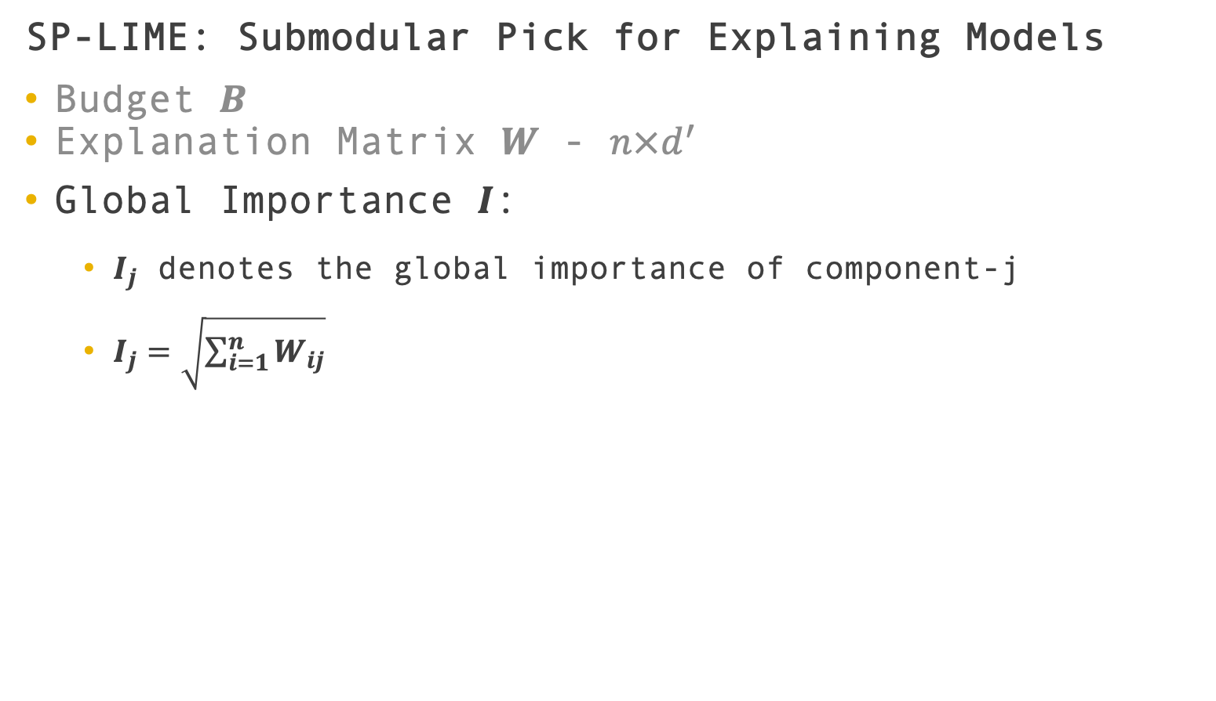
SP-LIME: Submodular Pick for Explaining Models
Budget $B$
Explanation Matrix $W$ - $n×d^{′}$
Global Importance $I$:
$I_{j}$ denotes the global importance of component-j
$I_{j}=\sqrt{\sum_{i=1}^{n}{W_{ij}}}$
$$I_{2}$$
SP-LIME: Submodular Pick for Explaining Models
Notes:
I_j is used to denote the global importance of the component-j (feature-j).
In this example, I_2 is the importance of feature f2, which is described in the blue dotted box.
And since feature 2 is used to explain more instances than the others, I_2 should be higher than other I$′$s.
# This example is for text. For images, I must measure something that is comparable across the super-pixels in different images, such as color histograms or other features of super-pixels; they leave further exploration of these ideas for future work.

Slide 32
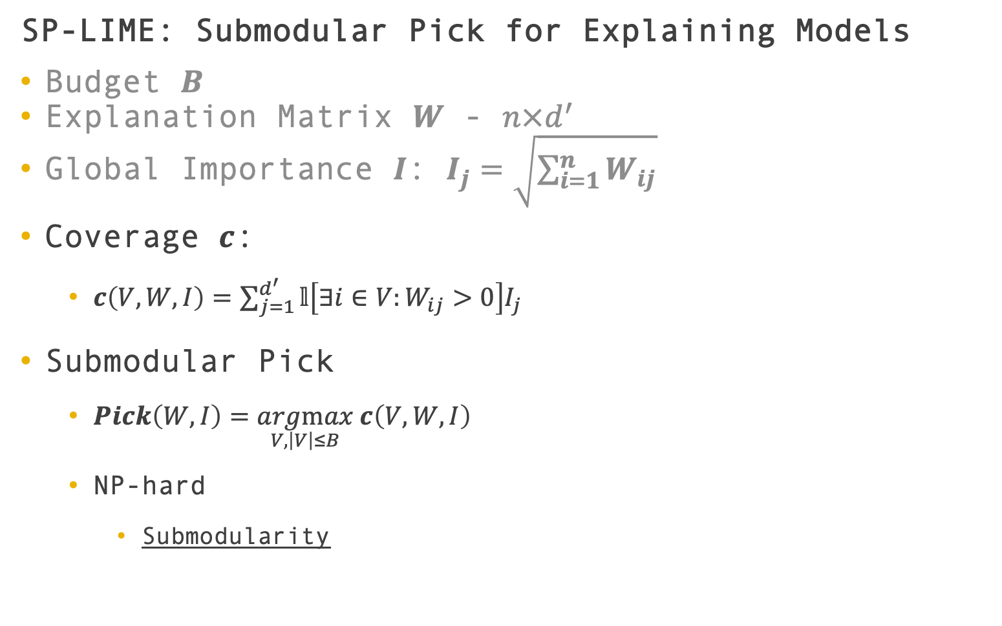
SP-LIME: Submodular Pick for Explaining Models
Budget $B$
Explanation Matrix $W$ - $n×d^{′}$
Global Importance $I$: $I_{j}=\sqrt{\sum_{i=1}^{n}{W_{ij}}}$
Coverage $c$:
$c\left(V,W,I\right)=\sum_{j=1}^{d^{′}}{𝕝\left[∃i∈V:W_{ij}>0\right]I_{j}}$
Submodular Pick
$Pick\left(W,I\right)=\underset{V,\left|V\right|≤B}{argmax} c\left(V,W,I\right)$
NP-hard
Submodularity
SP-LIME: Submodular Pick for Explaining Models
Notes:
Here it comes another question: how can we select the set of instances, which are representative and non-redundant.
We define another measurement - coverage c. It traverse all the d-prime features to see whether there is an instance whose weight of the feature is not zero.
PICK is to get the subset of instances to maximize the coverage c.
Essentially, we hope our instances cover as more interpretable components as possible.
However, this problem is NP-hard.
While the property of Submodularity could help us solve the problem.

Slide 33
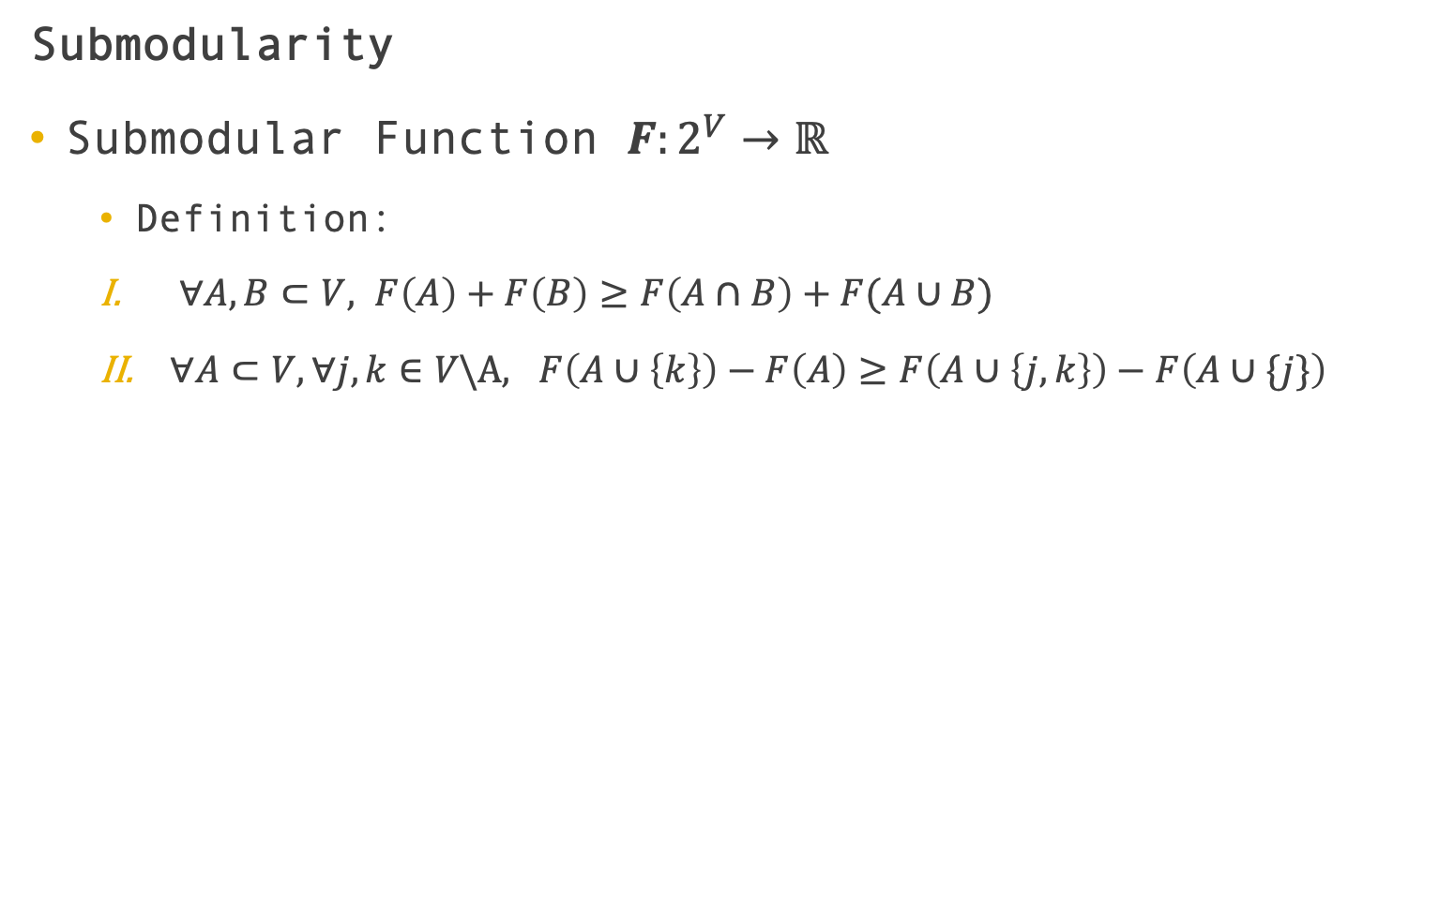
Submodularity
Submodular Function $F:2^{V}→ℝ$
Definition:
$∀A,B⊂V, F\left(A\right)+F\left(B\right)≥F\left(A∩B\right)+F(A∪B)$
$∀A⊂V,∀j,k∈V\backslash A, F\left(A∪\left\{k\right\}\right)−F\left(A\right)≥F\left(A∪\left\{j,k\right\}\right)−F\left(A∪\{j\}\right)$
SP-LIME: Submodular Pick for Explaining Models
Notes:
For our question, coverage id a submodular function; its input is a set of instances, and its output is a value.
And also, its definition. intersect union
For the same place, we try to add a sensor.
the performance of adding a sensor when the previous total coverage is relatively small is better than it is large.

Slide 34
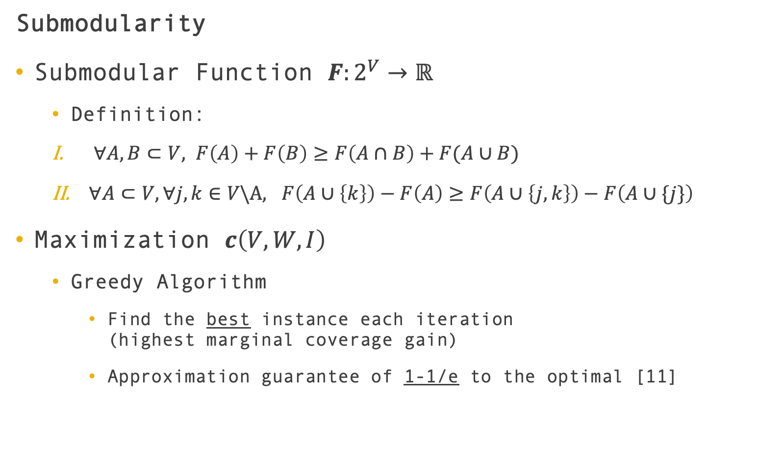
Submodularity
Submodular Function $F:2^{V}→ℝ$
Definition:
$∀A,B⊂V, F\left(A\right)+F\left(B\right)≥F\left(A∩B\right)+F(A∪B)$
$∀A⊂V,∀j,k∈V\backslash A, F\left(A∪\left\{k\right\}\right)−F\left(A\right)≥F\left(A∪\left\{j,k\right\}\right)−F\left(A∪\{j\}\right)$
Maximization $c\left(V,W,I\right)$
Greedy Algorithm
Find the best instance each iteration (highest marginal coverage gain)
Approximation guarantee of 1-1/e to the optimal [11]
SP-LIME: Submodular Pick for Explaining Models
Notes:
With the property of submodularity, we could get only 1-1/e to the optimal by greedy algorithm.

Slide 35
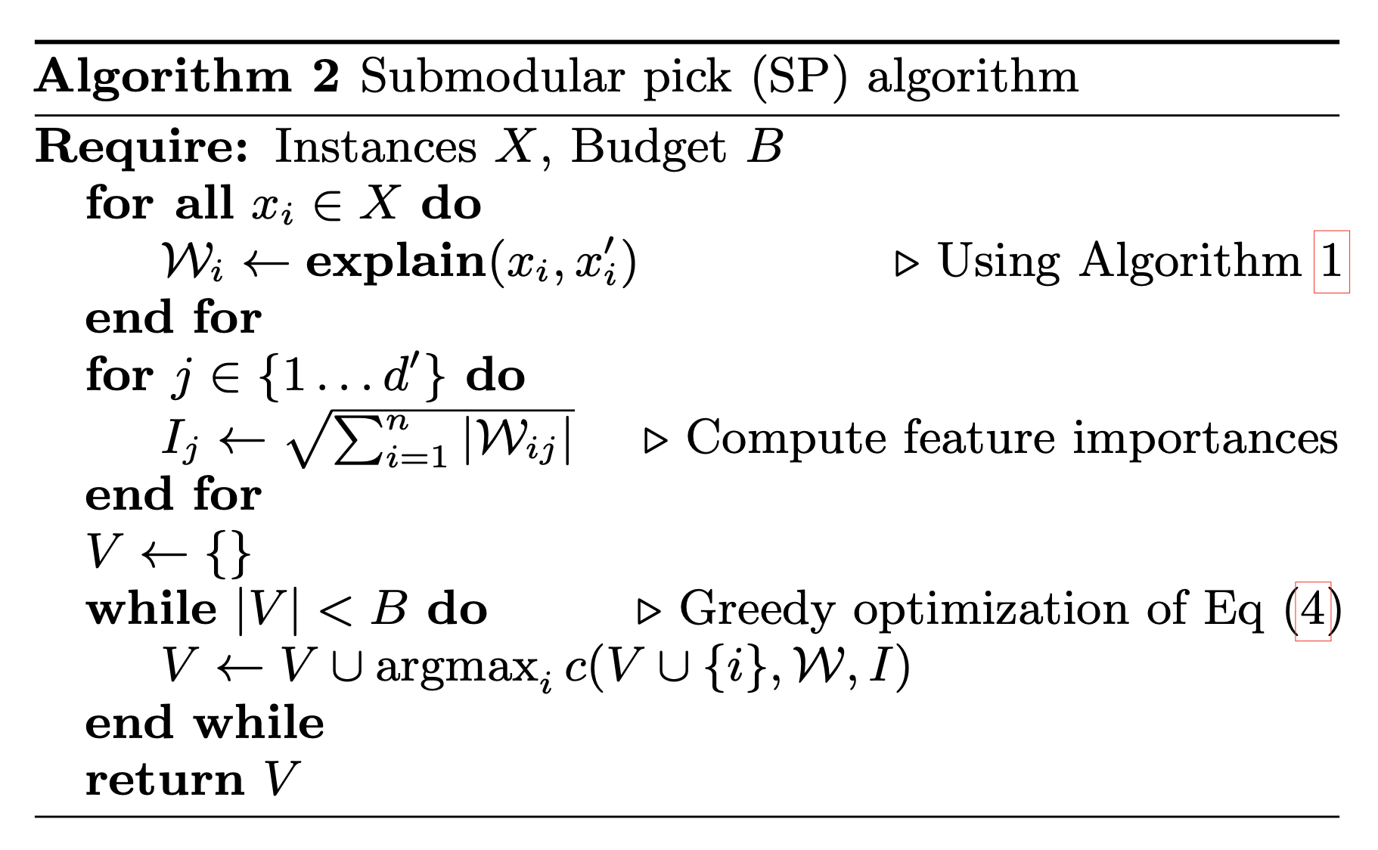
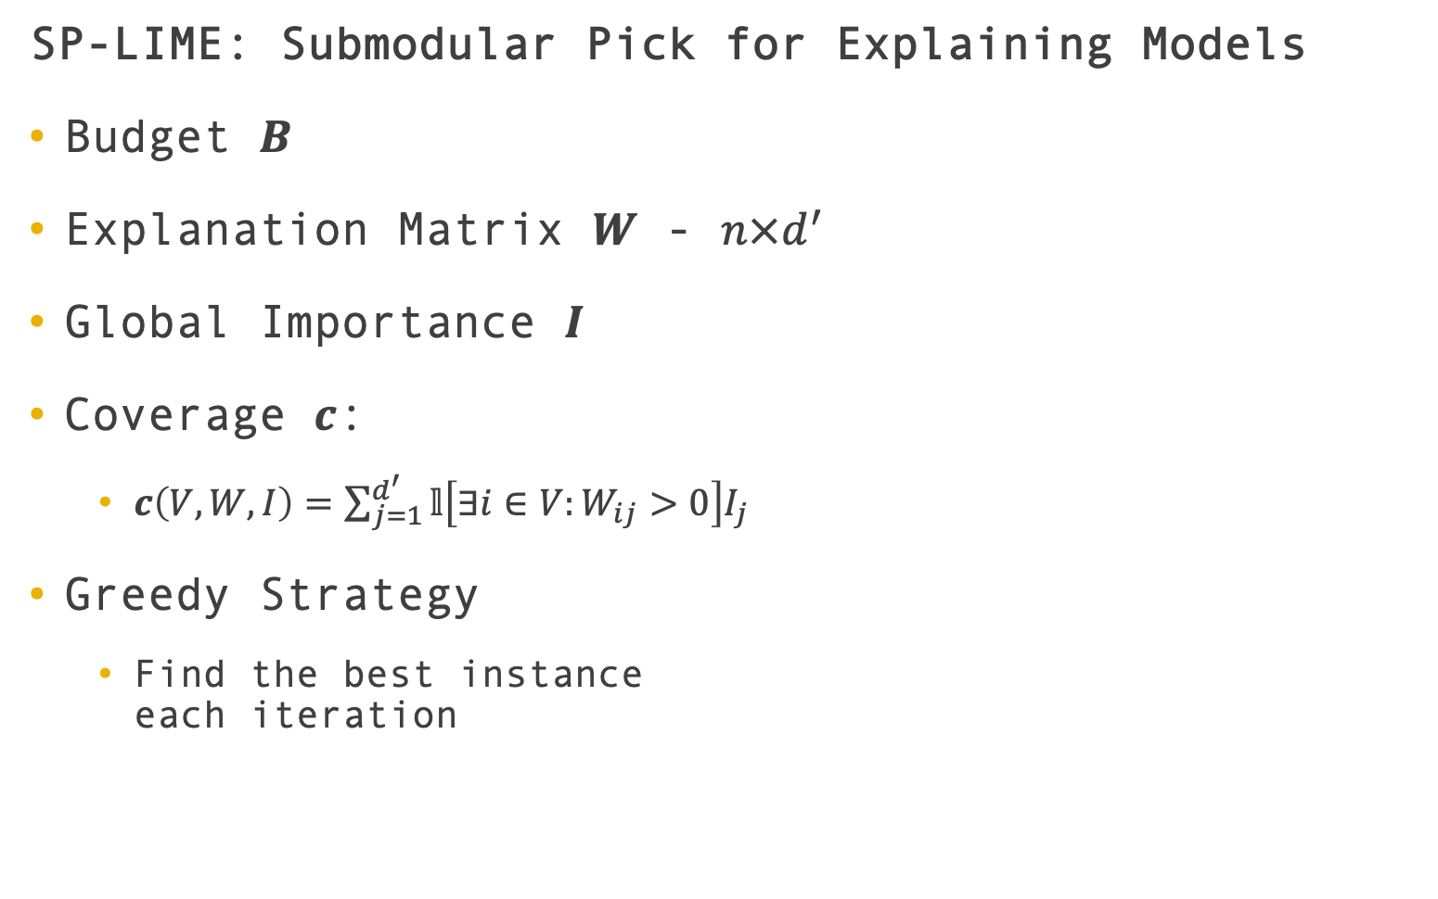
SP-LIME: Submodular Pick for Explaining Models
Budget $B$
Explanation Matrix $W$ - $n×d^{′}$
Global Importance $I$
Coverage $c$:
$c\left(V,W,I\right)=\sum_{j=1}^{d^{′}}{𝕝\left[∃i∈V:W_{ij}>0\right]I_{j}}$
Greedy Strategy
Find the best instance each iteration
SP-LIME: Submodular Pick for Explaining Models
Notes:
We can see the SP-LIME algorithm.

Slide 36

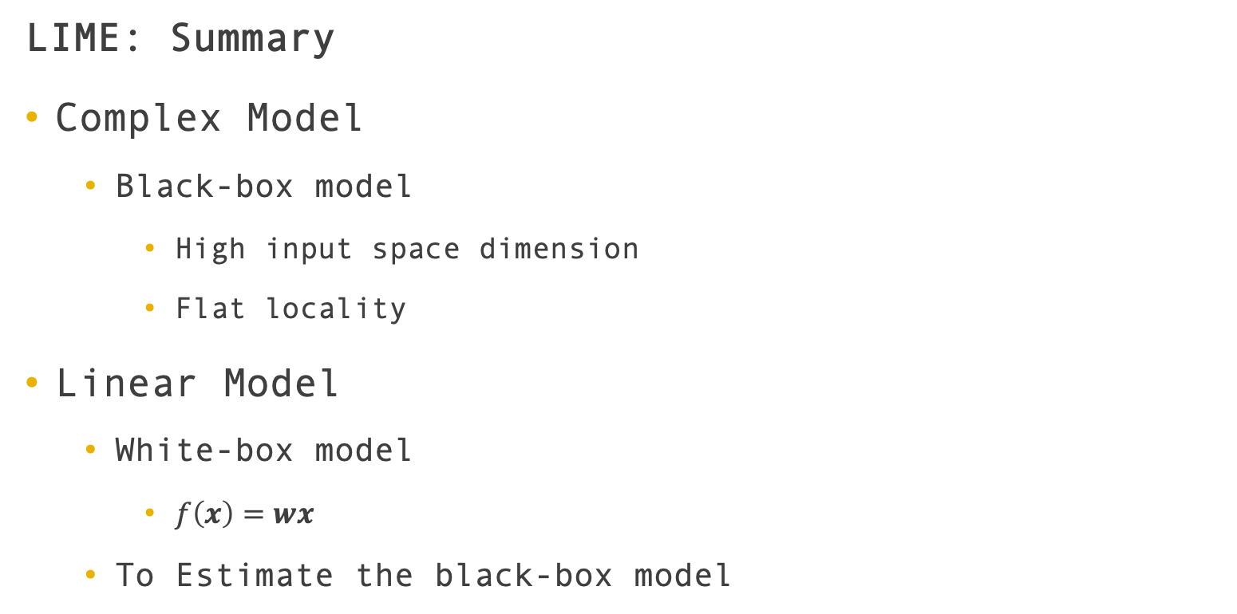
LIME: Summary
Complex Model
Black-box model
High input space dimension
Flat locality
Linear Model
White-box model
$f\left(x\right)=wx$
To Estimate the black-box model
LIME: Summary
Notes:
Although the model is very complex and the input space dimension is very high, the locality of the high-dimensional space is flat.
The local flatness guarantees a good training of LIME.
The linear model is a white box model, w determines the contribution of x to f(x).
A linear model can be used to approximate the behavior of the black box model near a particular input x_0.
This is the idea of LIME.

Slide 37
Interpreting Deep Learning Models for Entity Resolution: An Experience Report Using LIME [3]
ER Solutions
Magellan [7]
Deep Learning [6]
Mojito
Adapted LIME to ER task
Interpretable explanations of DL models applied to ER
Mojito: An Experience Report Using LIME
Notes:
Our topic today is the Entity Resolution Explanation.
Let’s take a look at the specific application of the explainer in Entity Resolution.
This paper tried to use LIME to understand the matching predictions of deep learning ER solutions.
They proposed a methods, Mojito, to produce interpretable explanations of DL models applied to ER.

Slide 38
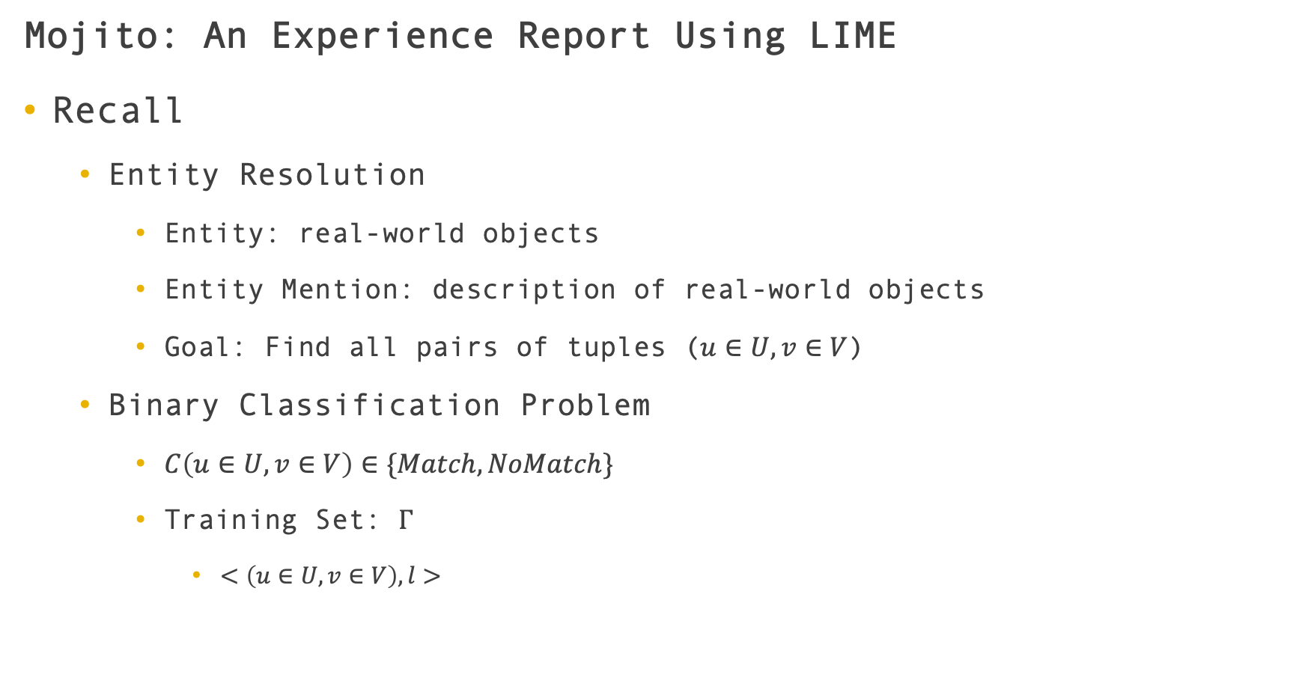
Mojito: An Experience Report Using LIME
Recall
Entity Resolution
Entity: real-world objects
Entity Mention: description of real-world objects
Goal: Find all pairs of tuples ($u∈U,v∈V$)
Binary Classification Problem
$C\left(u∈U,v∈V\right)∈\{Match,NoMatch\}$
Training Set: $Γ$
$<\left(u∈U,v∈V\right),l>$
Mojito: An Experience Report Using LIME

Slide 39
Mojito: An Experience Report Using LIME
Explain ER Prediction
Relationship
Components of the record
Model’s prediction
Mojito: An Experience Report Using LIME
Notes:
To explain an ER prediction, we need the information about the relationship between components of the record (e.g., attribute values, or words in text) and the model’s predictions.

Slide 40
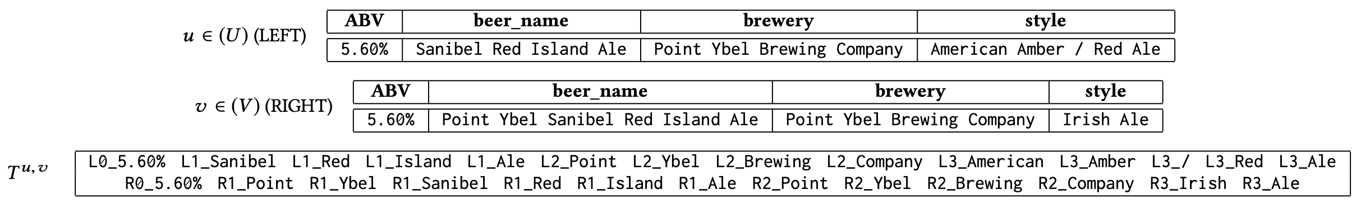
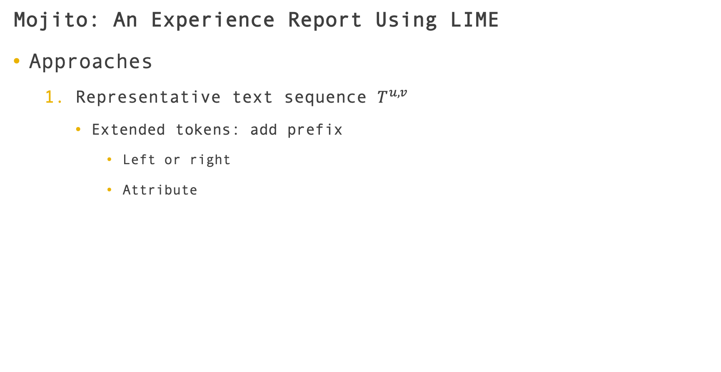
Mojito: An Experience Report Using LIME
Approaches
Representative text sequence $T^{u,v}$
Extended tokens: add prefix
Left or right
Attribute
Mojito: An Experience Report Using LIME
Notes:
Mojito first build a representative text sequence, T-u-v.

Slide 41
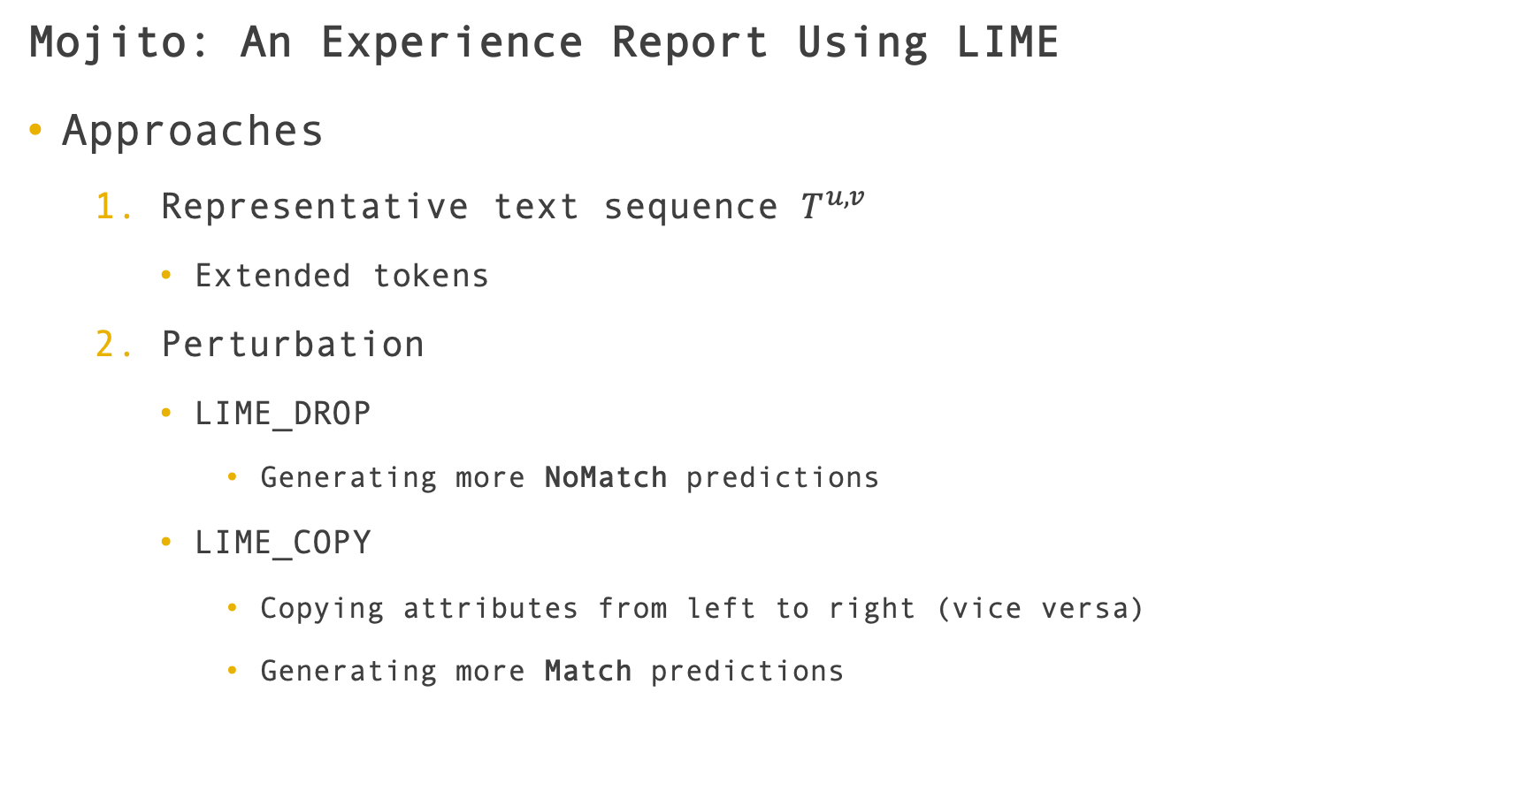
Mojito: An Experience Report Using LIME
Approaches
Representative text sequence $T^{u,v}$
Extended tokens
Perturbation
LIME_DROP
Generating more NoMatch predictions
LIME_COPY
Copying attributes from left to right (vice versa)
Generating more Match predictions
Mojito: An Experience Report Using LIME

Slide 42
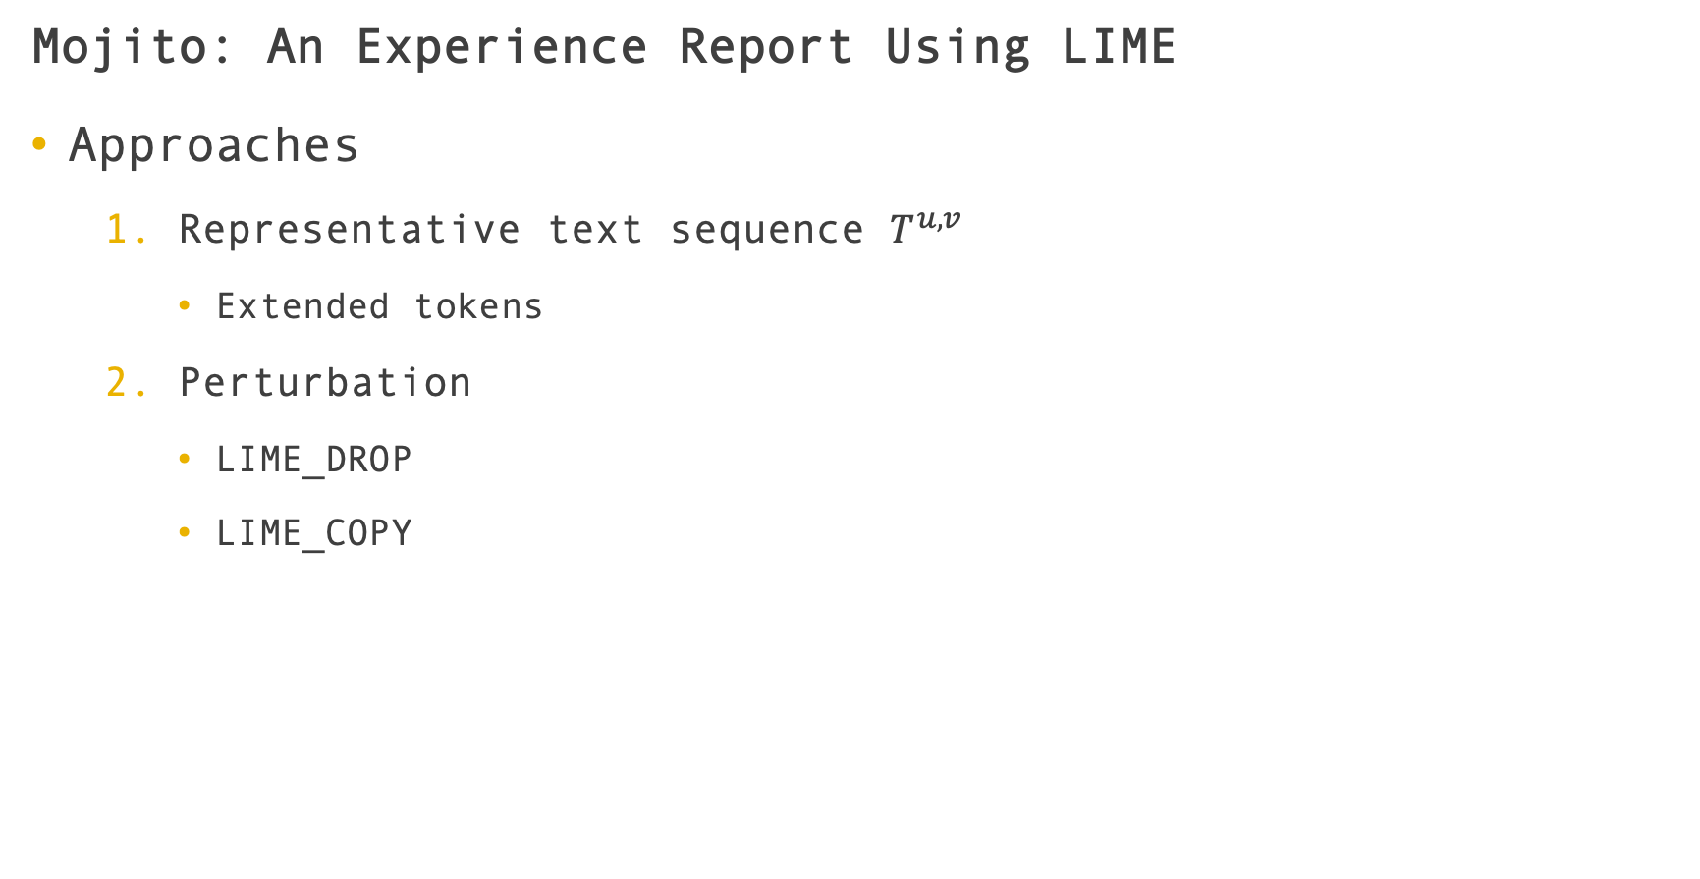
Mojito: An Experience Report Using LIME
Approaches
Representative text sequence $T^{u,v}$
Extended tokens
Perturbation
LIME_DROP
LIME_COPY
Mojito: An Experience Report Using LIME
Notes:
Example of LIME_COPY
Essentially, their approach computes the weights of each attribute and then we can find the relevance of each attribute in the classification process.

Slide 43
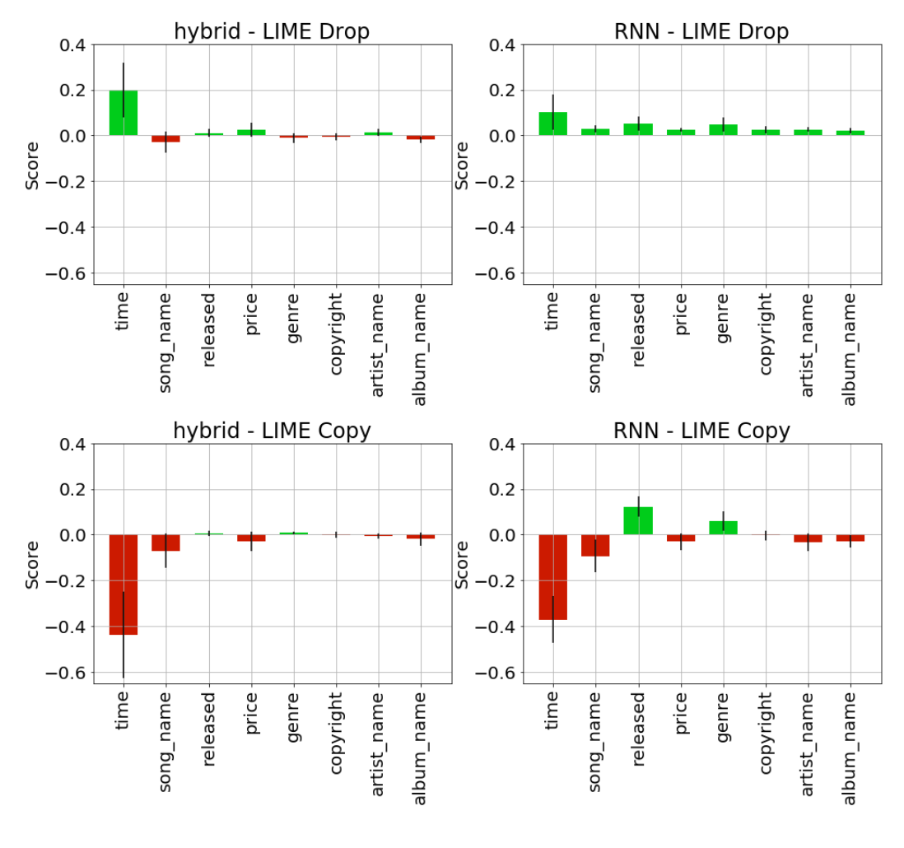
Mojito: An Experience Report Using LIME
iTunes-amazon dataset
Importance
Time attribute
Little relevance
Song name
album name
artist name
Sensitive
Time
Mojito: An Experience Report Using LIME
Notes:
They use three datasets to show the advantages and limitations of their approaches.
For iTunes-amazon dataset, the two methods both heavily rely on the time attribute, for both the match and noMatch class.
Some attributes that seem more important for humans, such as name of songs, albums and authors, seem to have little or no relevance.
To some extent, we could just change the time on two songs to flip their prediction, which is sensitive to the test data.

Slide 44
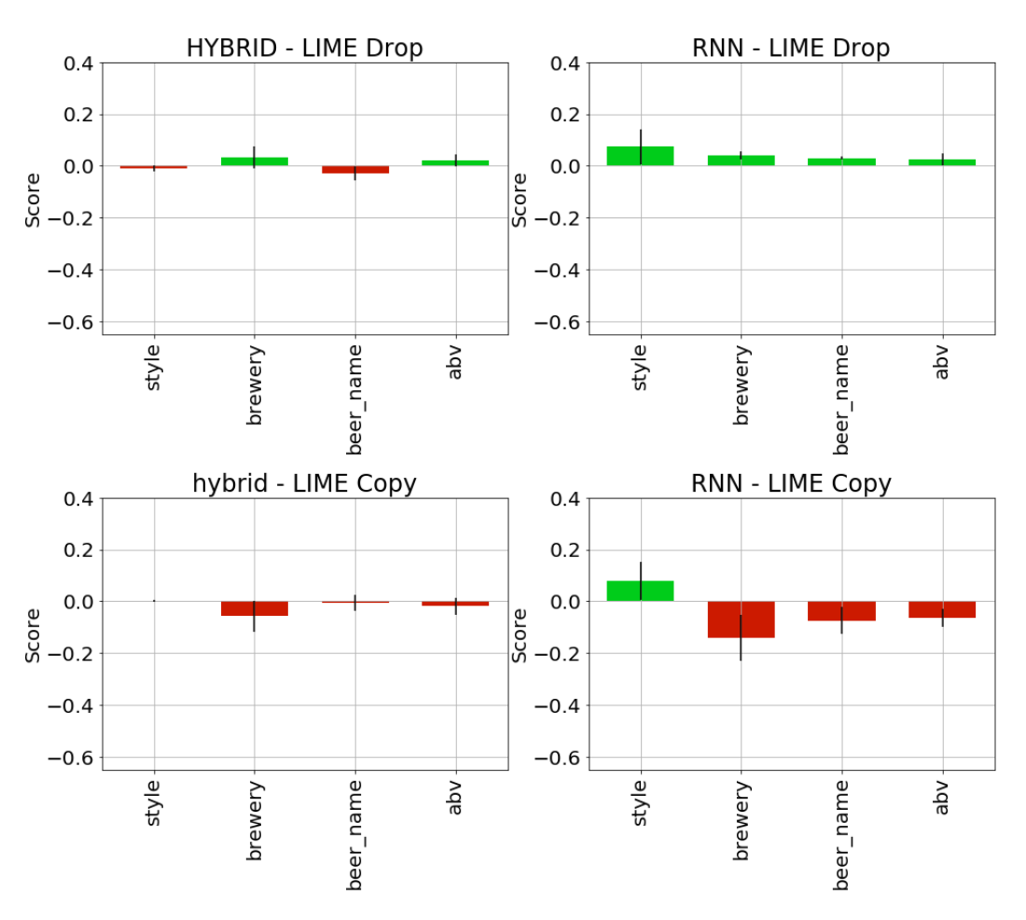
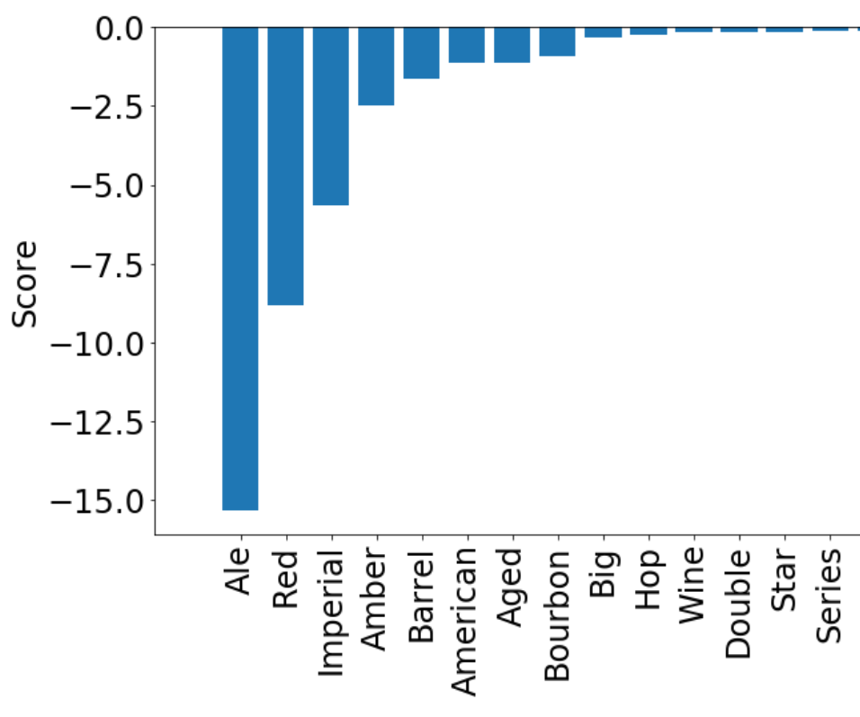
Mojito: An Experience Report Using LIME
Beers dataset
Sensitive
Imperial Red Ale
Mojito: An Experience Report Using LIME
Notes:
For beers dataset, we can see that the top three word tokens for beer name attribute are Ale, Red and Imperial.
Most noMatch pairs in the training set are about imperial red ales.
So we could change its prediction by simply appending the sequence “Imperial Red Ale” to any of the two beer names.
Maybe as the beers training set is small, the complex model is more sensitive to bias.
Here we might answer the question left by the last presentation.

Slide 45
Trust in Classifiers
Sensitivity
Training data
Test data
Robustness
Classifiers
Explainers
Notes:
We can see that these deep learning algorithms are also sensitive to both training data and test data.
Back to a basic question, why don't we trust models, especially neural networks?
It is hard to explain.
Also sensitivity is a very important factor.
Next I will introduce the research on the robustness of classifiers and explainers.

Slide 46
Robustness of Classifiers
Instability
Adversarial Perturbation
DeepFool- a simple and accurate method to fool deep neural networks [8]
Perturbations of the data samples
Small
Imperceptible
DeepFool: Fool the Classifiers
Notes:
For now, we consider an extreme situation that will help us think about the Robustness of models.
It’s Adversarial Perturbation.
This paper thought that very small and often imperceptible perturbations of the data samples are sufficient to fool state-of-the-art classifiers and result in incorrect classification.

Slide 47
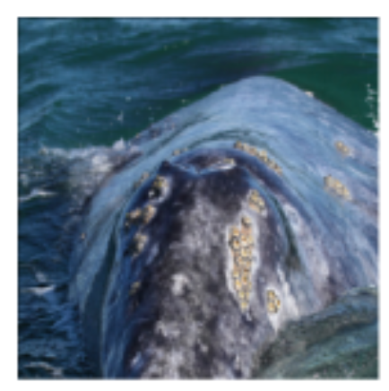
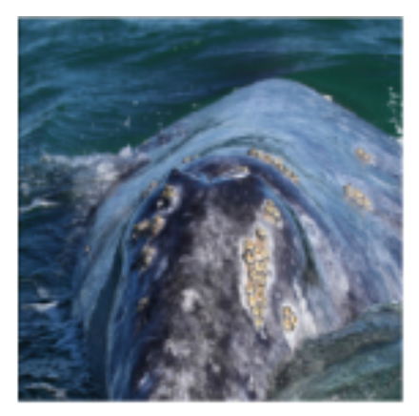
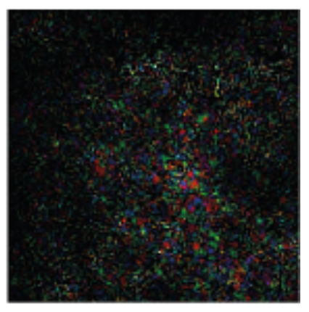
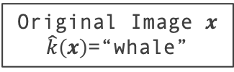
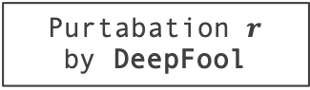
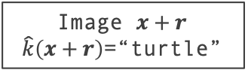
DeepFool: Fool the Classifiers
Example: Whale and Turtle
Image $x+r$
$\hat{k}\left(x+r\right)$=“turtle”
Purtabation $r$
by DeepFool
Original Image $x$
$\hat{k}\left(x\right)$=“whale”
DeepFool: Fool the Classifiers
Notes:
Here is an example, the original image x that is classified as whale. Modified by corresponding perturbation r, the image x + r is classified as turtle.

Slide 48
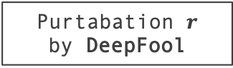
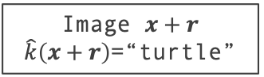
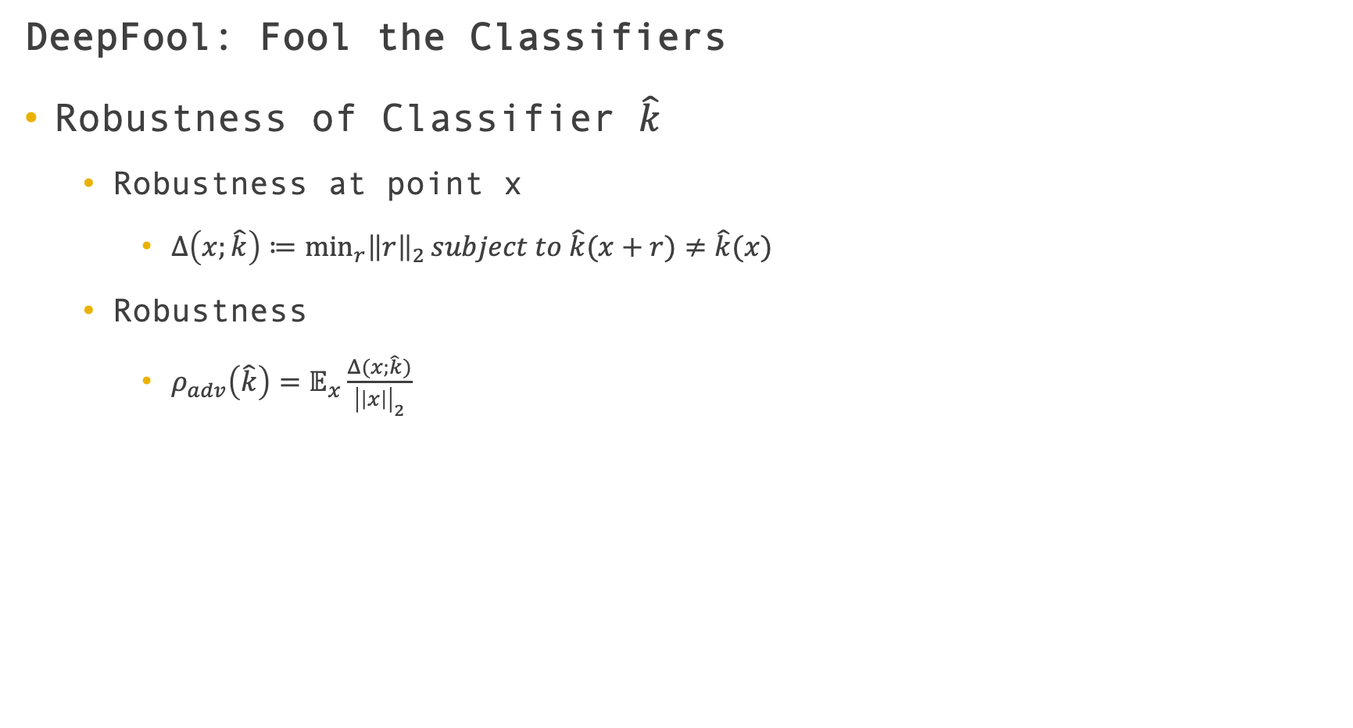
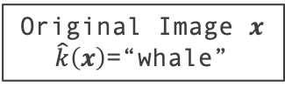
DeepFool: Fool the Classifiers
Robustness of Classifier $\hat{k}$
Robustness at point x
$Δ\left(x;\hat{k}\right)≔\min_{r}{{\left\|r\right\|}_{2}}subject to \hat{k}(x+r)≠\hat{k}(x)$
Robustness
$ρ_{adv}\left(\hat{k}\right)=𝔼_{x}\frac{Δ(x;\hat{k})}{{\left|\left|x\right|\right|}_{2}}$
Image $x+r$
$\hat{k}\left(x+r\right)$=“turtle”
Original Image $x$
$\hat{k}\left(x\right)$=“whale”
Purtabation $r$
by DeepFool
DeepFool: Fool the Classifiers
Notes:
Inspired by r, we define the robustness of a classifier $\hat{k}$ as $Δ\left(x;\hat{k}\right)$. $Δ\left(x;\hat{k}\right)$ is the robustness of k at point x
And the robustness of classifier $\hat{k}$ is $ρ$, which is the expectation of normalized robustness over the distribution of data.

Slide 49
DeepFool: Fool the Classifiers
Weak Generalization Ability
Sensitive to small adversarial perturbations
Misclassifying minimally perturbed data
Visually similar to normal samples
Robustness of Classifiers
Notes:
The existence of such examples is seemingly in contradiction with the generalization ability of the learning algorithms.
they are not robust at all to small adversarial perturbations and tend to misclassify minimally perturbed data that looks visually similar to clean samples.
Though adversarial attacks are specific to the classifier, it seems that the adversarial perturbations are generalizable across different models

Slide 50
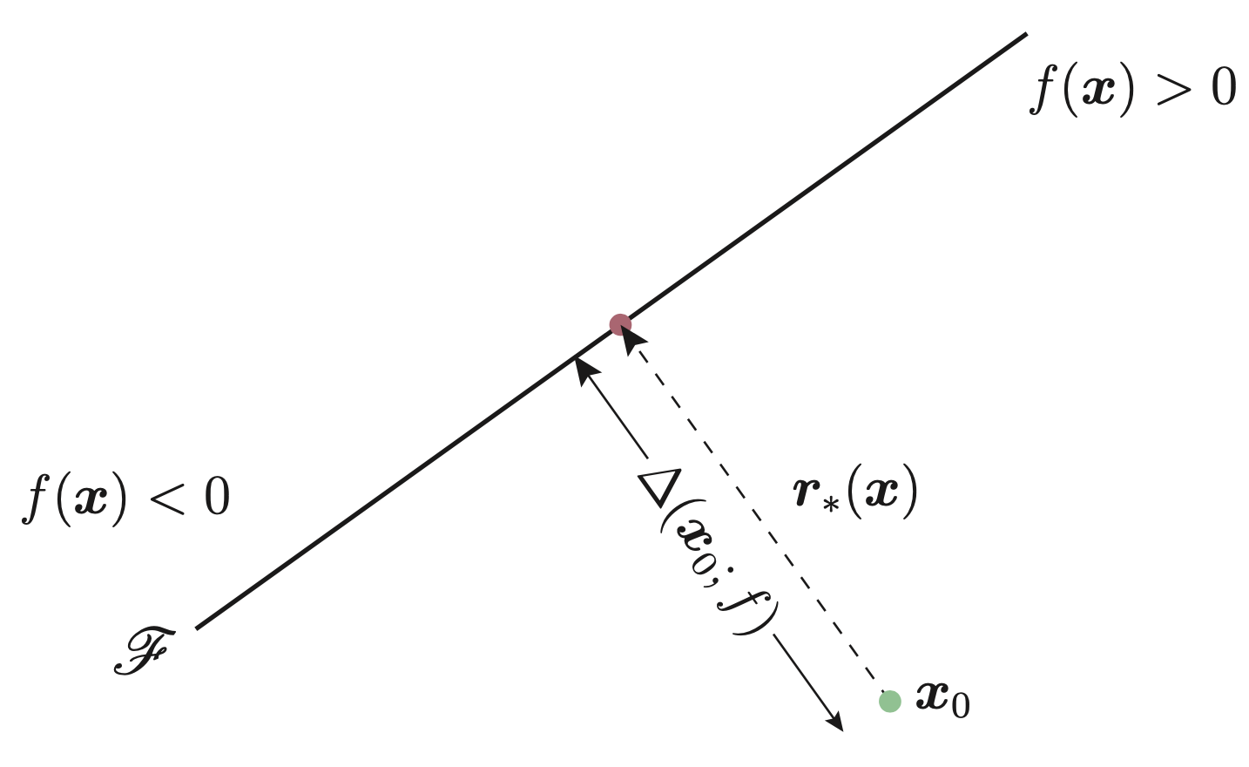

DeepFool: Fool the Binary Classifiers
Binary Classifiers
Hyper-plane
Each side corresponds different classification results
To change the classification
Cross the split plane
Vertical shortest way == Robustness of $x_{0}$
Robustness of Classifiers
Notes:
In this presentation, I will only skim through the DeepFool for binary classifiers. If you are interested in fooling the multi-class classifiers, please refer to the papers.
As shown in the figure, the binary classification problems are assumed that the segmentation plane is a hyper-plane, and the two sides of the plane correspond to different classification results.
If you want to change the prediciton, you must cross the split plane. Obviously the shortest way is the vertical movement.
The distance is the robustness of x_0.
r is the minimal perturbation.

Slide 51


DeepFool: Fool the Binary Classifiers
Binary Classifiers
To change the classification
Cross the split plane
Vertical shortest way == Robustness of $x_{0}$
Iteration approach
Approaching the hyper-plane
Multi-class Classifier
Choosing the direction
To find the shortest way
Robustness of Classifiers
Notes:
For an irregular hyperplane, we use iteration methods.
At each iteration, the gradient is calculated such that the point is approaching the hyper-plane with a small moving distance.
While the multi-classification problem is similar to the binary problem, we just need to consider which direction is the shortest way when moving to different classification labels at each iteration.

Slide 52

Adversarial Perturbation and Classifiers Explainer
Fine-tuning using adversarial examples
Increasing robustness
Adversarial Perturbation and Classifiers Explainer
Notes:
The study of Adversarial Perturbation could also help us understand what features are used by a classifier.
Also, augmenting training data with adversarial examples significantly increases the robustness to adversarial perturbations.

Slide 53
Adversarial Perturbation and Classifiers Explainer
Fine-tuning using adversarial examples
Increasing robustness
Improving the accuracy
Classifier | Test Error Before fine-tuning | Test Error After fine-tuning
LeNet (MNIST) | 1% | 0.8%
FC500-150-10 (MNIST) | 1.7% | 1.5%
NIM (CIFAR-10) | 11.5% | 11.2%
LeNet (CIFAR-10) | 22.6% | 20.0%
Adversarial Perturbation and Classifiers Explainer
Notes:
Also, it can be seen that fine-tuning with DeepFool can improve the accuracy of the networks.
# While, large transformations of the original samples may have a counter-productive effect on generalization.

Slide 54


Universal Adversarial Perturbations
Same perturbation
Image-agnostic
Small / Non-significant affect
Universal Adversarial Perturbations [9]
${\left|\left|v\right|\right|}_{p}≤ ξ$
$ℙ_{x\sim μ}\left(\hat{k}\left(x+v\right)≠\hat{k}(x)\right)≥1−δ$
Universal Adversarial Perturbations
Notes:
Besides DeepFool, we can even make universal adversarial perturbations.
How can we add the same perturbation to different images can cause the image to be misclassified by the classifier, regardless of the picture?
It seems impossible. But it does exist.
The paper shows the existence of such imperceptible universal perturbation vectors that lead to misclassify natural images with high probability.
How can we find the universal perturbation? It should be small and works for most images from the data distribution $μ$.

Slide 55



Universal Adversarial Perturbations
Iteration
$Δv$
$v+Δv→l_{p} Ball$
Universal Adversarial Perturbations
Notes:
So the idea of the algorithm is:
For each iteration, if the current v is not enough to disturb x, then we will look for a Δv and then update the perturbation.
# In order to make v small enough, the author projects (v+Δv) onto a ball with a radius of $ξ$
Essentially, it is to try to approach the desired v as close as possible.

Slide 56

Universal Adversarial Perturbations
500 images -> 30%
4000 images -> 70%
Fooling ratios on the set X, and the validation set
Universal Adversarial Perturbations

Slide 57

Universal Adversarial Perturbations
Cross-model universality
Doubly-universal
Fine-tuning the network
Mild improvement in the robustness
Universal Adversarial Perturbations
Notes:
This result shows that the universal perturbations generalize well across data points and very different architectures.
Also, the fine-tuning the network leads to a mild improvement in the robustness.

Slide 58

Universal Adversarial Perturbations
Measuring the sensitivity to universal perturbations
Types of Perturbations
Universal adversarial perturbation
Random perturbation
Adversarial perturbation computed for a randomly picked sample
DF methods
FGS methods
Sum of adversarial perturbations over X
Mean of the images
Universal Adversarial Perturbations
Notes:
It can also be used to measure the sensitivity of models.
The graph shows the fooling rate on the validation set with respect to the l2 norm of the perturbation of different.
The proposed universal perturbation quickly reaches very high fooling rates, even with a small norm.

Slide 59

Universal Adversarial Perturbations
Measuring the sensitivity to universal perturbations
Types of Perturbations
Random perturbation
Required norm: $Θ(\sqrt{d}{\left|\left|r\right|\right|}_{2})$
Universal adv. pert.
Exploiting some geometric correlations between different parts of the decision boundary
Universal Adversarial Perturbations
Notes:
For random perturbation, required norm should be …
r is the distance between this point x and the decision boundary.
For universal adversarial perturbations, it is much better than random perturbation,
which suggests that the universal perturbation exploits some geometric correlations between different parts of the decision boundary of the classifier.

Slide 60

Universal Adversarial Perturbations
Measuring the sensitivity to universal perturbations
For each image x in the validation set
Adversarial perturbation vector r(x)
$r\left(x\right)=\min_{r}{{\left\|r\right\|}_{2}}subject to \hat{k}(x+r)≠\hat{k}(x)$
Local geometry of the decision boundary in the region surrounding x
Normal vectors N
Decision boundary in the vicinity of n data points
$N=\left[\begin{aligned}\frac{r\left(x_{1}\right)}{{\left|\left|r\left(x_{1}\right)\right|\right|}_{2}} \\ \frac{r\left(x_{2}\right)}{{\left|\left|r\left(x_{2}\right)\right|\right|}_{2}} \\ … \\ \frac{r\left(x_{n}\right)}{{\left|\left|r\left(x_{n}\right)\right|\right|}_{2}}\end{aligned}\right]$
Binary classifier: rank 1
Complex models: computing the singular values
Universal Adversarial Perturbations
Notes:
For each image x in the validation set, we compute the adversarial perturbation vector r(x).
it should captures the local geometry of the decision boundary in the region surrounding the data point x
Then the normal vectors captures the decision boundary in the vicinity of n data points in the validation set
for binary classifier, N is rank 1.
for more complex models, we compute the singular values of the matrix N.

Slide 61


Universal Adversarial Perturbations
Measuring the sensitivity to universal perturbations
For each image x in the validation set
Adversarial perturbation vector r(x)
$r\left(x\right)=\min_{r}{{\left\|r\right\|}_{2}}subject to \hat{k}(x+r)≠\hat{k}(x)$
Normal vectors N
$N=$ $\left[\begin{aligned}\frac{r\left(x_{1}\right)}{{\left|\left|r\left(x_{1}\right)\right|\right|}_{2}} \\ … \\ … \\ \frac{r\left(x_{n}\right)}{{\left|\left|r\left(x_{n}\right)\right|\right|}_{2}}\end{aligned}\right]$
Existence of large correlations and redundancies in the decision boundary.
Universal Adversarial Perturbations
Notes:
As we all known, the singular values often correspond to important information implied in the matrix, and the importance is positively correlated with the size of the singular values.
We can see from the curve, the blue line is a random vector and the red dotted line is for the normal vector.
For the normal vector, at the beginning of the curve, the singular value changes very much, and afterwards, the curve becomes smooth.
That means deep networks have large correlations and redundancies in the decision boundary.

Slide 63
Robustness of Explainers
Prediction-based Explainers
Saliency Approaches
Inferring salient features from gradients or output decomposition
Perturbation Approaches
Inferring importance of features from querying the model around the prediction of interest
Limitations
Sensitive to input’s transformation and reference point [13]
Single point-wise explanation is too optimistic
Robustness of Explainers
Notes:
Next, let’s talk about the robustness of explainers.
The explainers can be roughly divided into two categories: saliency and perturbation approaches.
Saliency and perturbations approaches.
LIME is a kind of perturbation approaches.
However, most saliency methods are not invariant under simple transformations of the input, and are very sensitive to the choice of reference point.
And understanding a complex model with a single point-wise explanation is perhaps too optimistic

Slide 64
Robustness of Explainers
Robustness to Local Perturbation
Helping the explainers generate meaningful explanations
Properties
Similar inputs -> similar explanations
Simplified model -> complex model
On the Robustness of Interpretability Methods [2]
Robustness of Explainers
Notes:
Robustness to local perturbation could help the explainers generate meaningful explanations.
Similar inputs should not lead to substantially different explanations.
The simplified model can be used to represent the true complex model, at least in a small neighborhood.
This part refers to this paper.

Slide 65

Robustness of Explainers
Instability
SVM
NN
Robustness of Explainers
Notes:
So where is the instability of the explainers?
For the SVM model, you can see that the explanations of the neighboring points are very close.
However, the neural networks are opposite, which means the explanation to such complex model is not robust.

Slide 66





Robustness of Explainers
Local Lipschitz Continuity
Robustness
$$δ$$
$$x_{0}$$
$$x$$
Robustness of Explainers
Notes:
Essentially, if L is high enough, two similar input will get very different output.

Slide 67

Robustness of Explainers
Robustness of Explainers
Notes:
We find an example xi and xj, which maximize the L.
Similar input and prediction, different explanation.

Slide 68

Robustness of Explainers
Robustness of Explainers
Notes:
The perturbed version of the image is mostly indistinguishable from the original input to the human eye, while the explanations are remarkably different.
# The model predicts the same class.

Slide 69
Summary
Explainer. LIME is a flexible method for explaining different models for text (e.g. random forests) and image classification (e.g. neural networks) by learning a transparent surrogate – such as linear regression – for a given instance on an interpretable feature space (e.g., text tokens or super-pixels). Different from other interpretable models, LIME approximates the model locally, instead of approximate the original model as a whole.
Robustness. A case study of explaining deep learning models using LIME, Mojito, shows the sensitivity of these models. DeepFool used the adversarial perturbation to define the robustness of a classifier and how we can use the adversarial perturbations to attack or improve the models. [2] used Local Lipschitz Continuity to analyze the robustness of explainers. The analysis of the robustness (such as fine-tuning training data with perturbations) could help the models to be more robust and accurate.
Notes:
LIME try to explain different models by learning a transparent surrogate, such as linear regression. This surrogate is used to weight the importance of different interpretable features for a given instance.

Slide 70

References
[1] Ribeiro, Marco Tulio, Sameer Singh, and Carlos Guestrin. "Why should i trust you?: Explaining the predictions of any classifier." Proceedings of the 22nd ACM SIGKDD international conference on knowledge discovery and data mining. ACM, 2016.
[2] Alvarez-Melis, David, and Tommi S. Jaakkola. "On the robustness of interpretability methods." arXiv preprint arXiv:1806.08049 (2018).
[3] Di Cicco, Vincenzo, et al. "Interpreting deep learning models for entity resolution: an experience report using LIME." Proceedings of the Second International Workshop on Exploiting Artificial Intelligence Techniques for Data Management. ACM, 2019.
[4] Szegedy, Christian, et al. "Going deeper with convolutions." Proceedings of the IEEE conference on computer vision and pattern recognition. 2015.
[5] Amershi, Saleema, et al. "Modeltracker: Redesigning performance analysis tools for machine learning." Proceedings of the 33rd Annual ACM Conference on Human Factors in Computing Systems. ACM, 2015.
[6] Mudgal, Sidharth, et al. "Deep learning for entity matching: A design space exploration." Proceedings of the 2018 International Conference on Management of Data. ACM, 2018.
[7] Konda, Pradap, et al. "Magellan: Toward building entity matching management systems." Proceedings of the VLDB Endowment 9.12 (2016): 1197-1208.

Slide 71
References
[8] Moosavi-Dezfooli, Seyed-Mohsen, Alhussein Fawzi, and Pascal Frossard. "Deepfool: a simple and accurate method to fool deep neural networks." Proceedings of the IEEE conference on computer vision and pattern recognition. 2016.
[9] Moosavi-Dezfooli, Seyed-Mohsen, et al. "Universal adversarial perturbations." Proceedings of the IEEE conference on computer vision and pattern recognition. 2017.
[10] Marcotcr. Lime: Explaining the predictions of any machine learning classifier. https://github.com/marcotcr/lime
[11] Krause, Andreas, and Daniel Golovin. "Submodular function maximization." (2014): 71-104.
[12] Hans, Chris. "Bayesian lasso regression." Biometrika 96.4 (2009): 835-845.
[13] Kindermans, Pieter-Jan, et al. "The (un) reliability of saliency methods." Explainable AI: Interpreting, Explaining and Visualizing Deep Learning. Springer, Cham, 2019. 267-280.

Slide 72



Thanks for Listening
Daren Chao
drchao@cs.toronto.edu

Slide 73
Appendix

Slide 74
Trust
Trusting a prediction
Individual prediction
Decision making
Trusting a model
Whether the user trusts a model
Deploying the model “in the wild”
Notes:
It is important to define two different definitions of trust.
In some cases, it is impossible to make predictions based on blind faith, as the consequences can be catastrophic, such as using machine learning for medical diagnosis or terrorism detection.
Apart from trusting individual predictions, there is also a need to evaluate the model as a whole before deploying it “in the wild”
To make this decision, users need to be confident that the model will perform well on real-world data.

Slide 75

LIME
Faithfulness to the model
LIME: Summary

Slide 76

LIME
Trustworthiness of the prediction
LIME: Summary

Slide 77

LIME
Helping users select trustworthy classifiers
LIME: Summary

Slide 78

Mojito: Experiences
Walmart-amazon dataset.
Mojito: An Experience Report Using LIME

Slide 79
Robustness of Explainers
Robustness of Mojito
Robustness of Explainers

